Slide 1

The Lincoln Academy of Illinois
Student Laureates
2025

Slide 2
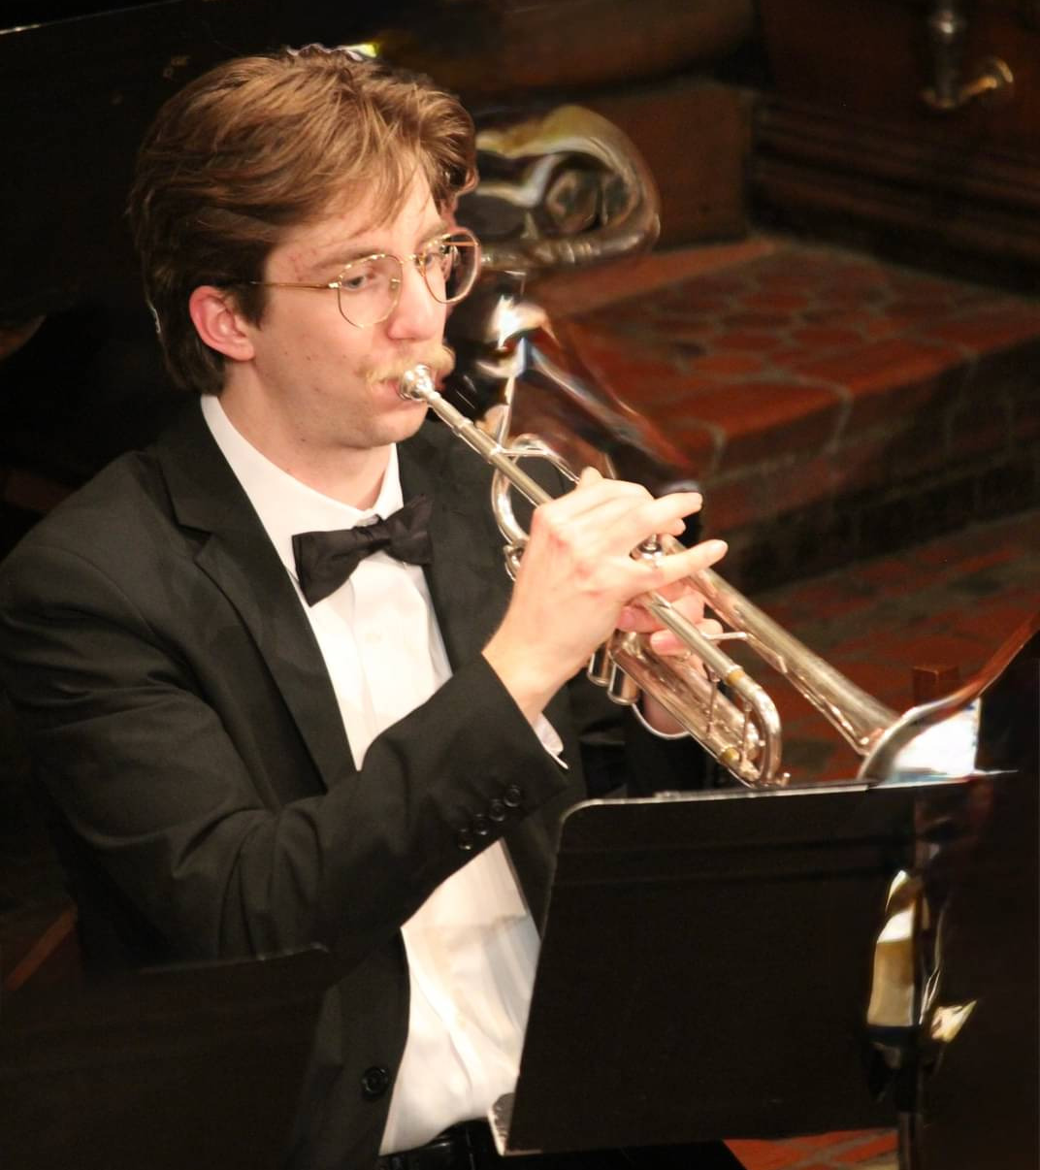
Ian Max Empen
Augustana College

Slide 3
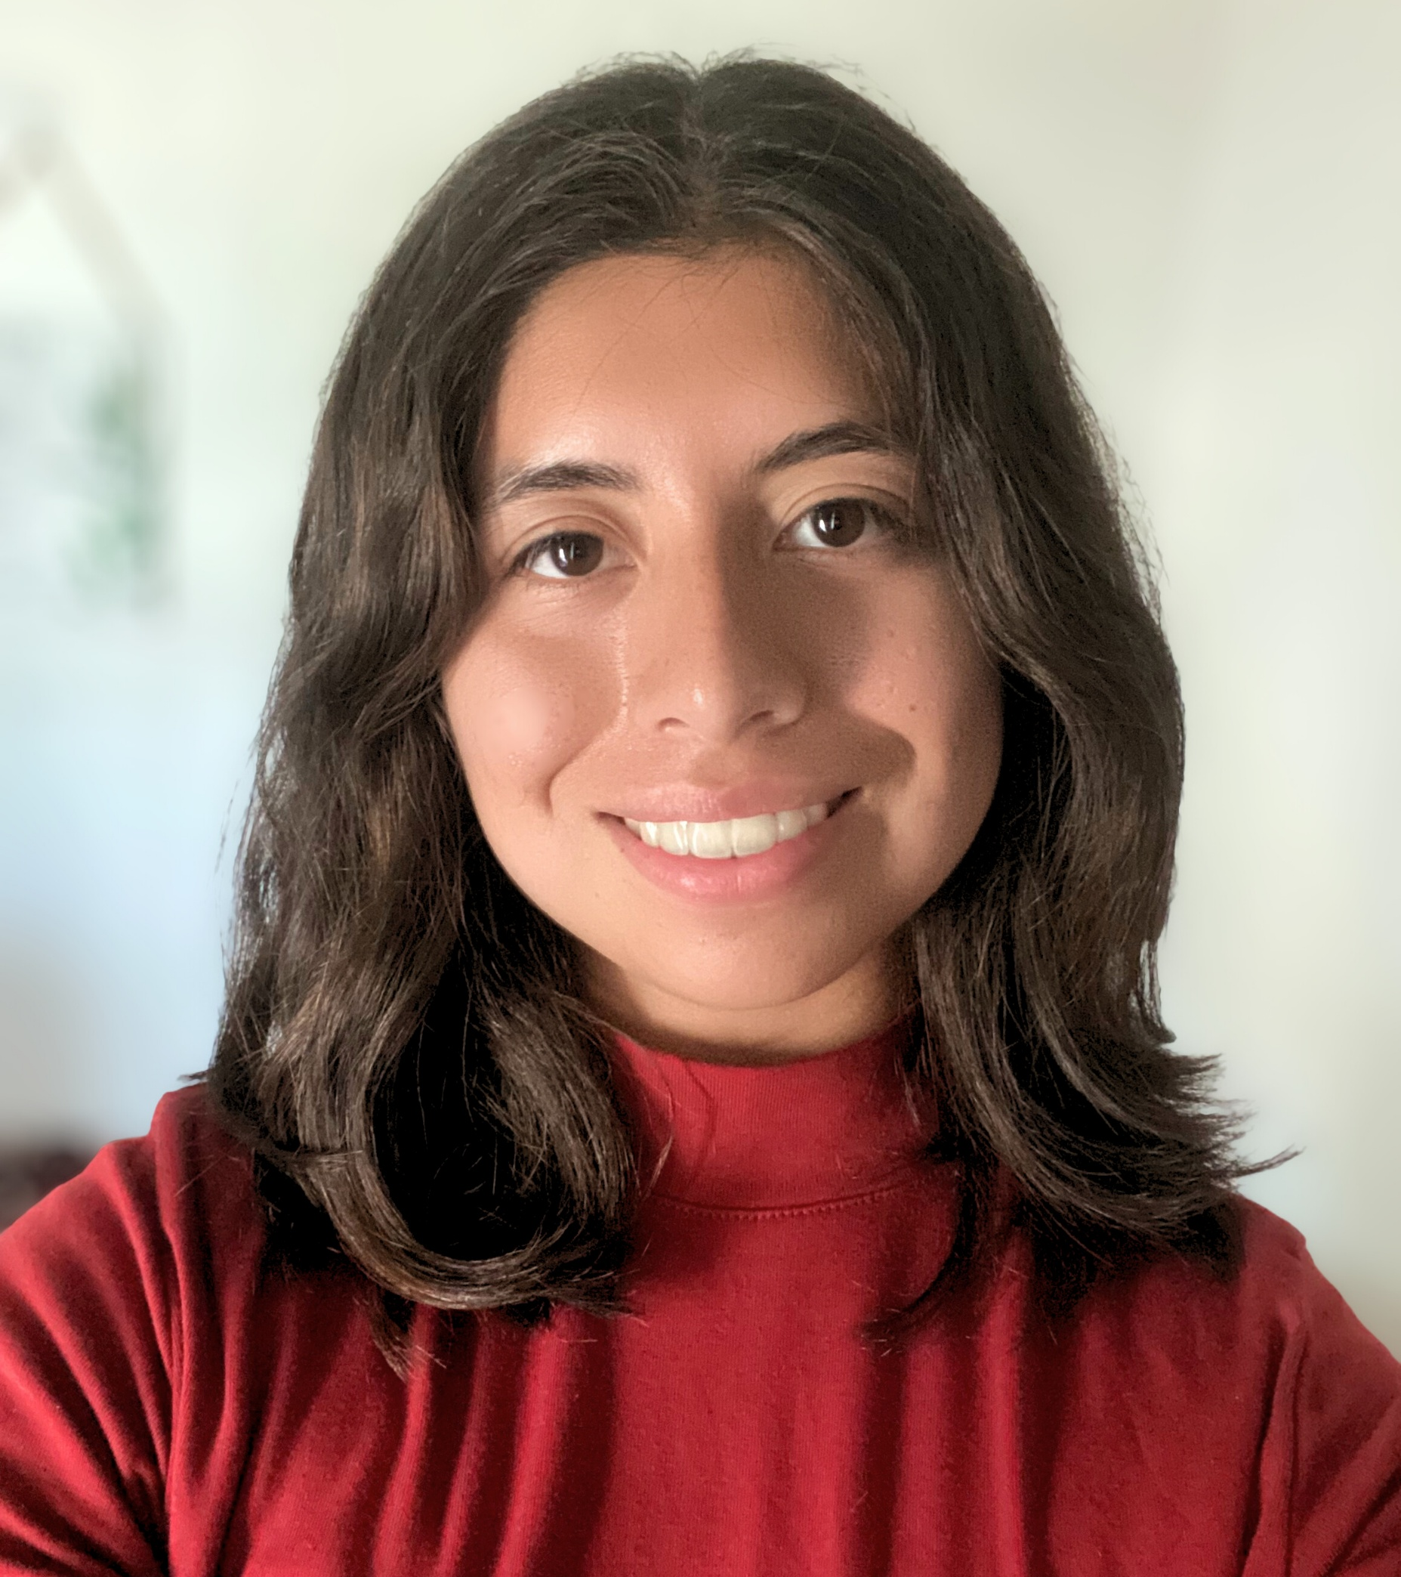
Diane Elaine Fuentes
Aurora University

Slide 4
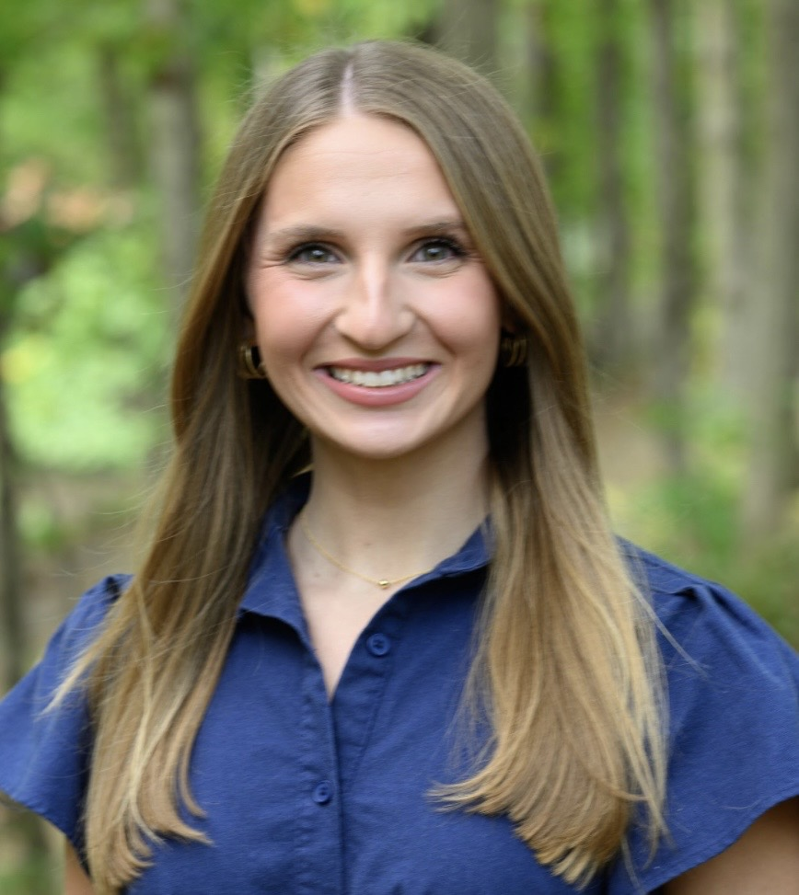
Daleigh Ann
Johnson-Pawlak
Benedictine University

Slide 5
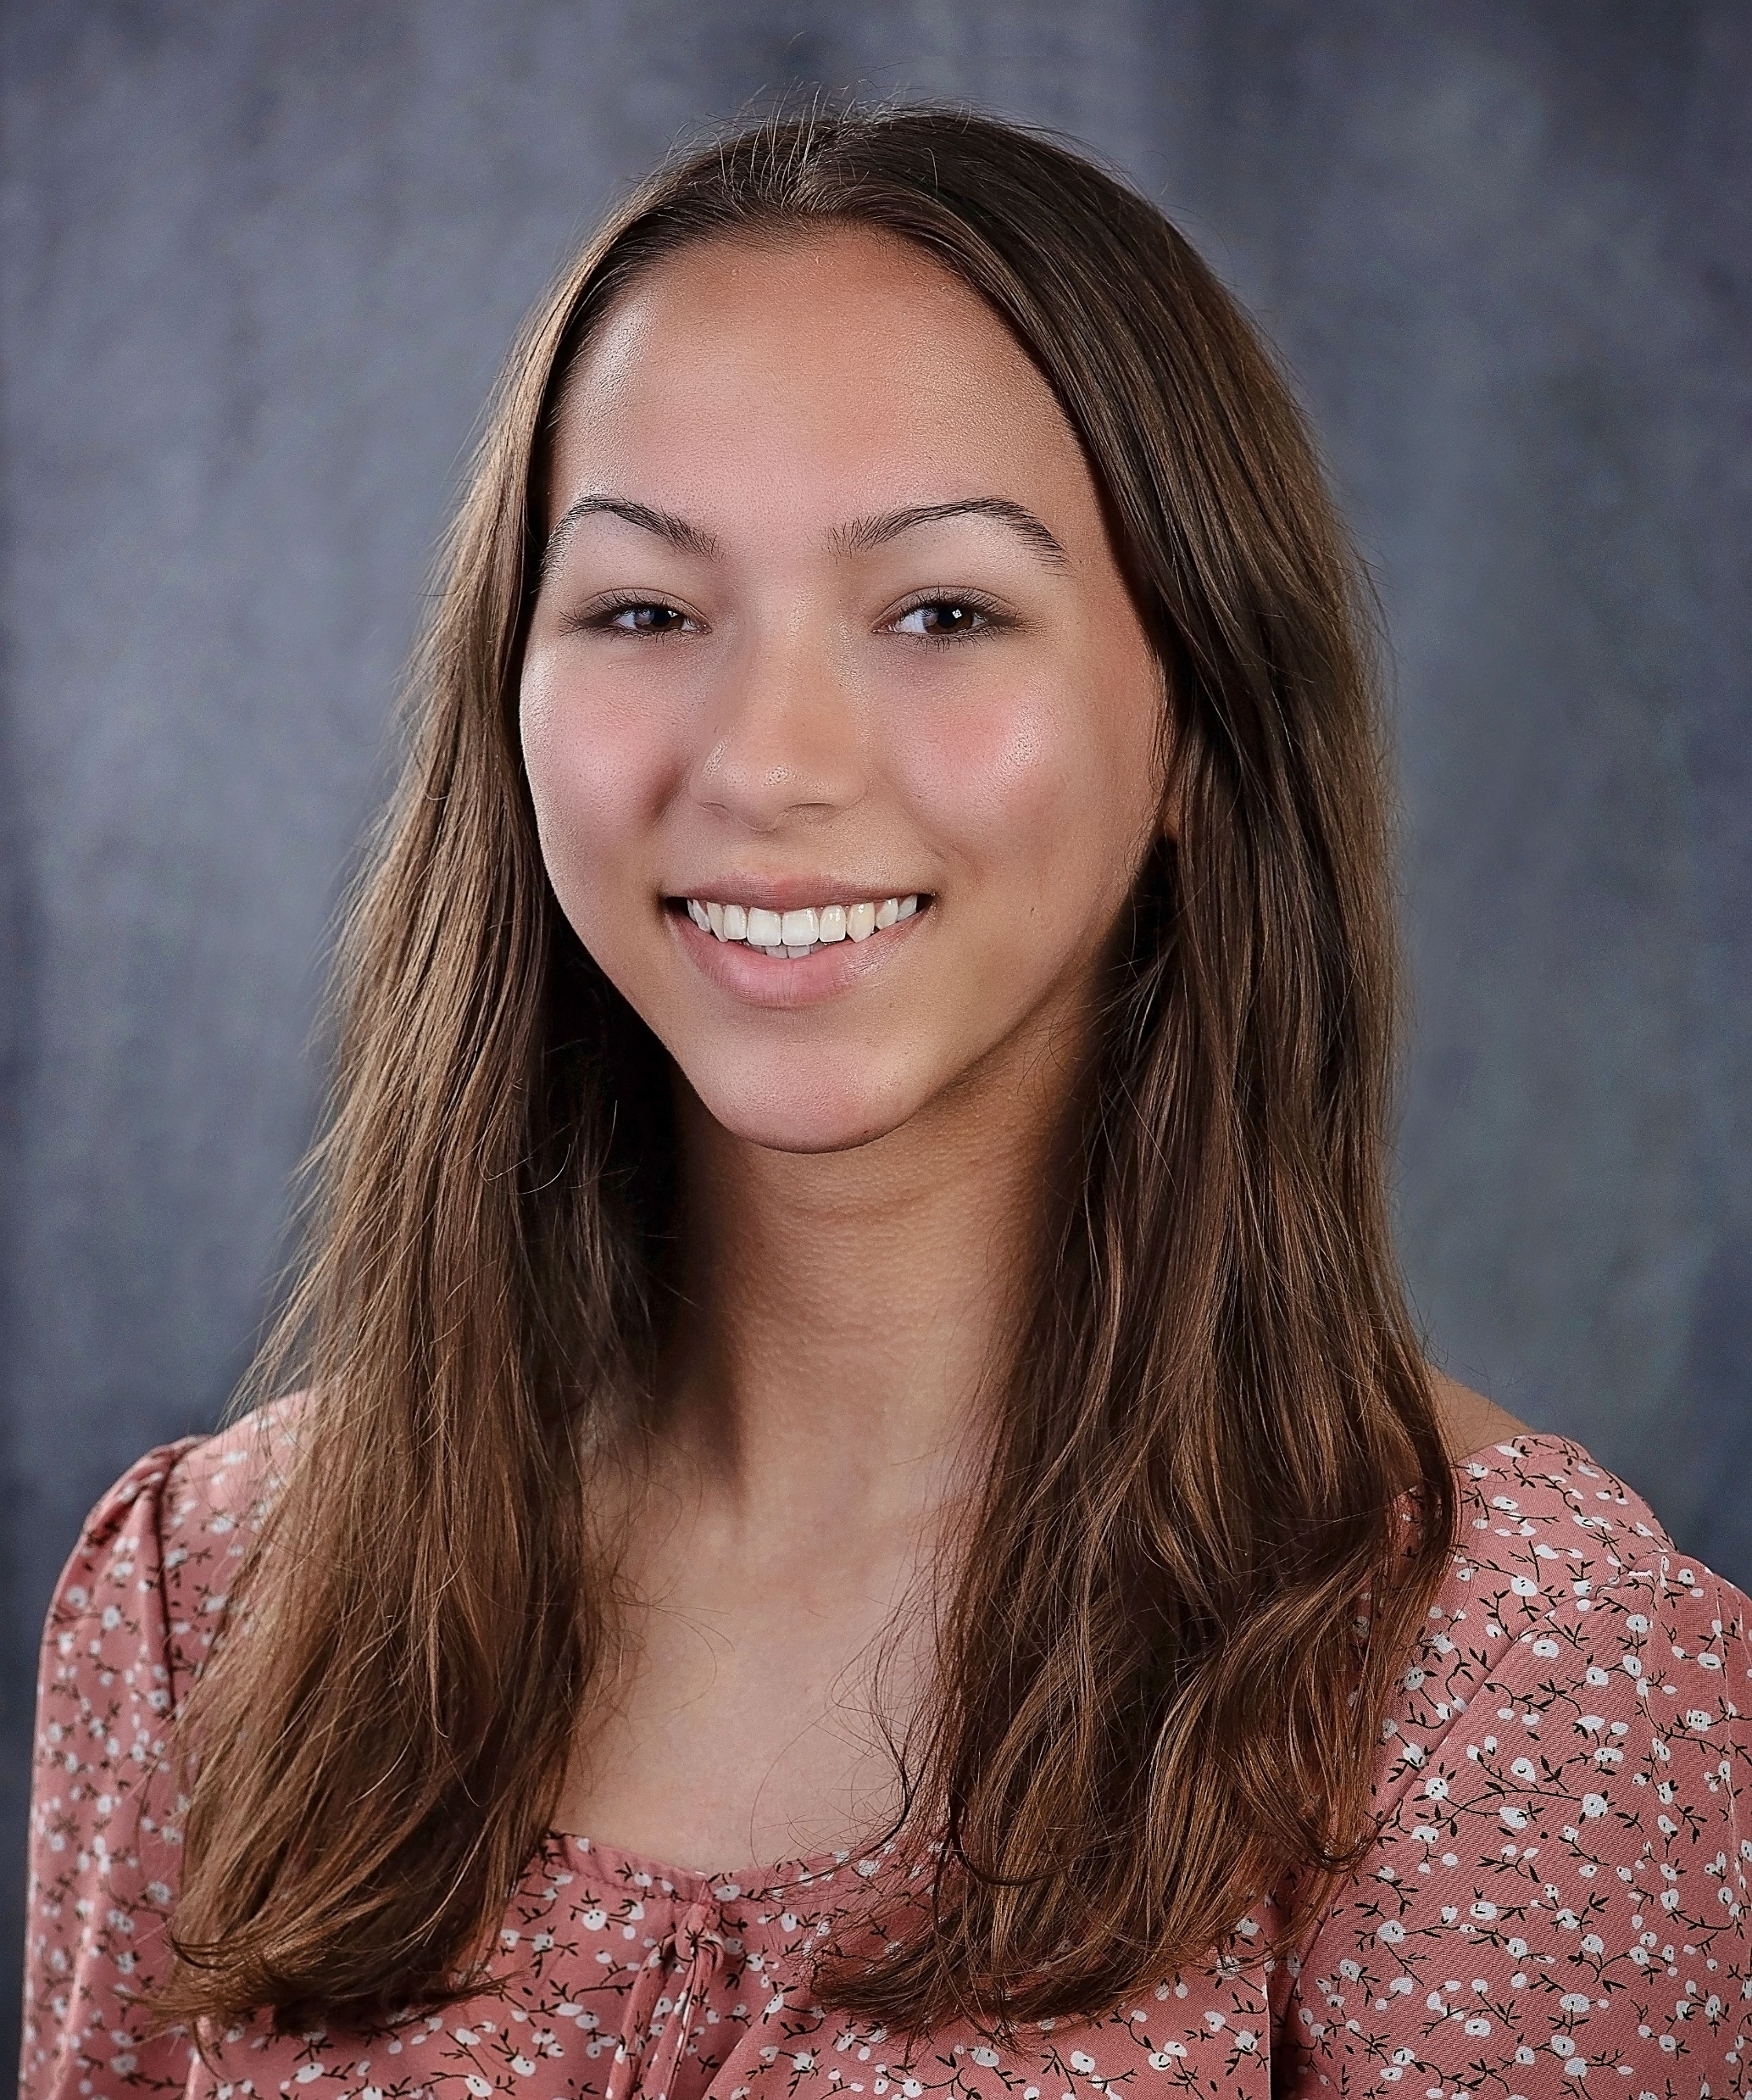
Peyton Dahler
Blackburn College

Slide 6
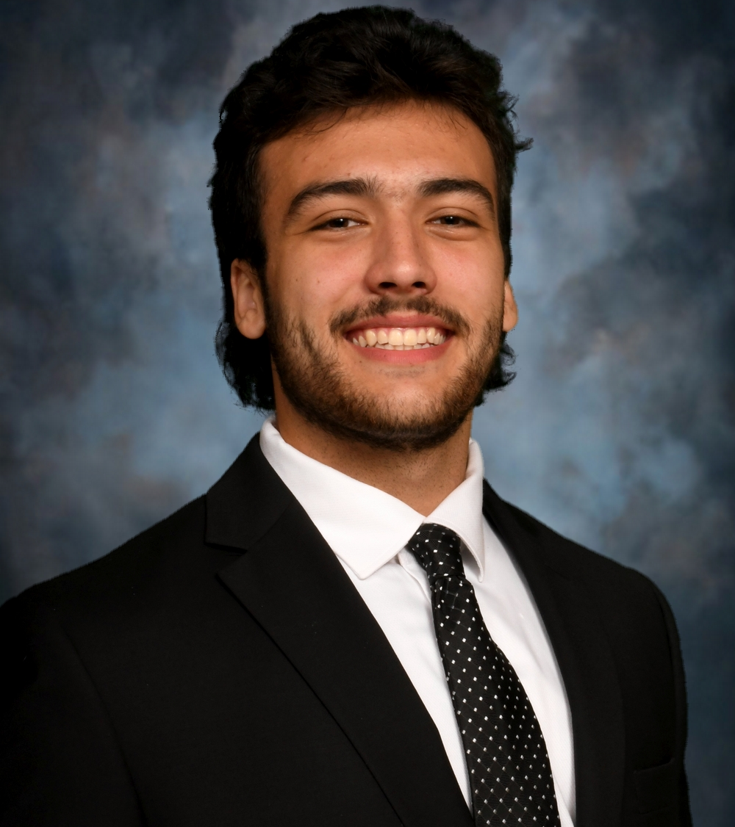
Joseph Kenneth Traskaski
Bradley University

Slide 7
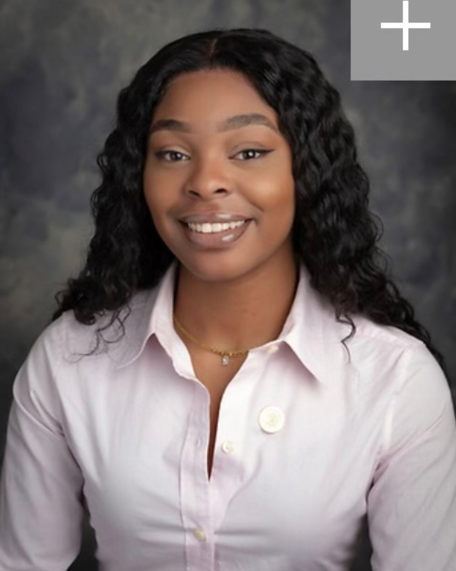
Allison Bolden
Chicago State University

Slide 8
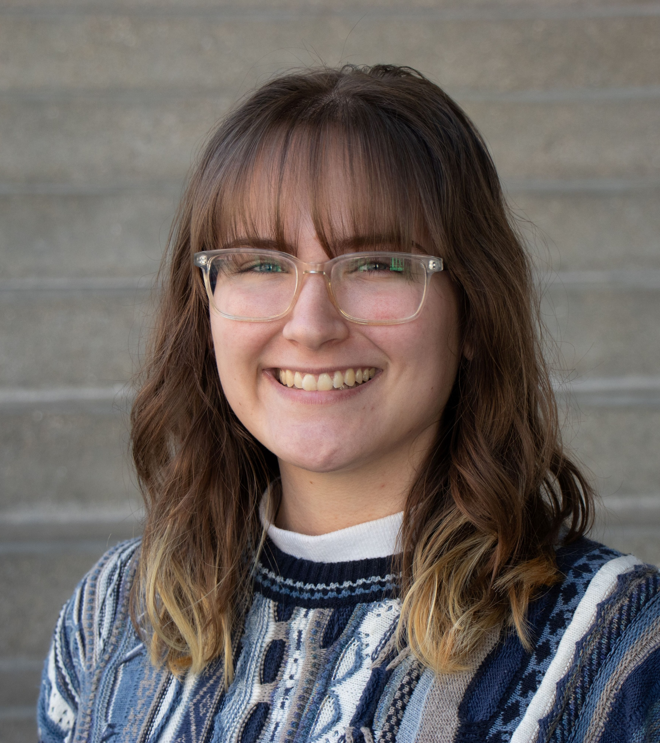
Jenna Rose Davis
Columbia College Chicago

Slide 9
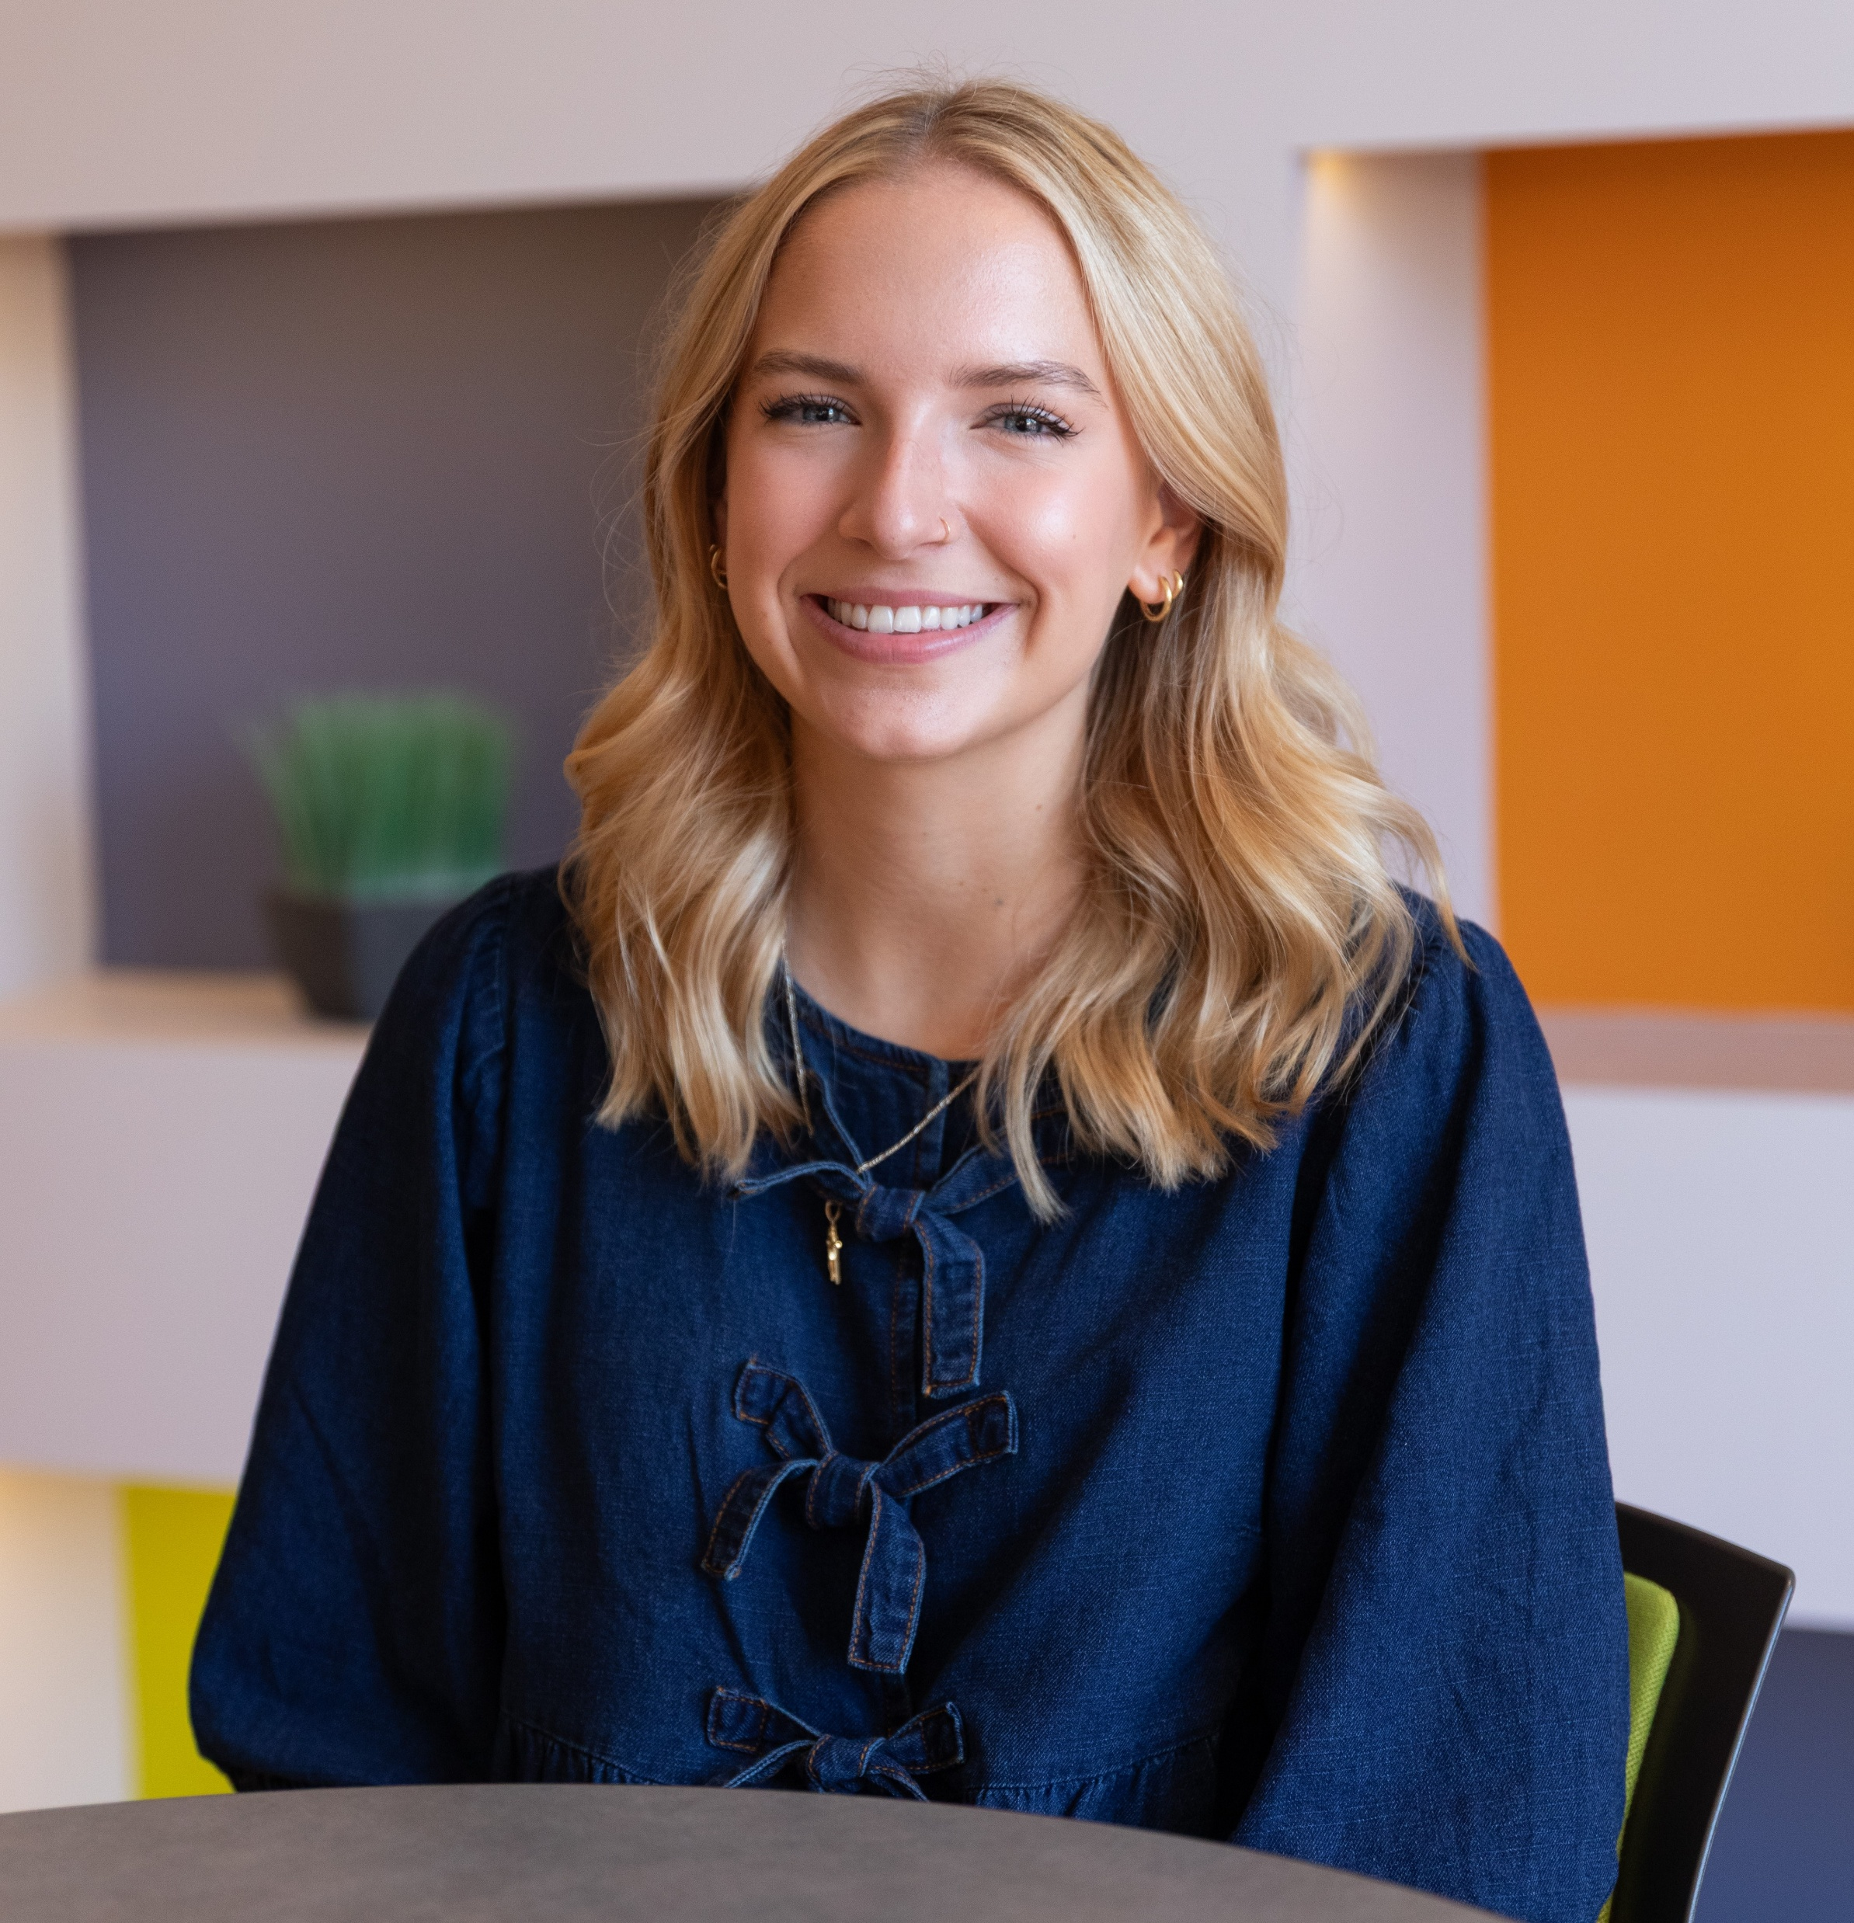
Lillian Frances Seifferlein
Concordia University Chicago

Slide 10
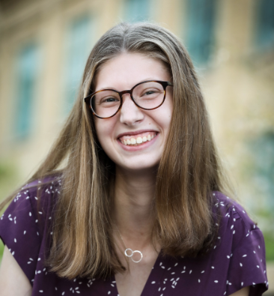
Natashia Jean Johannes
DePaul University

Slide 11
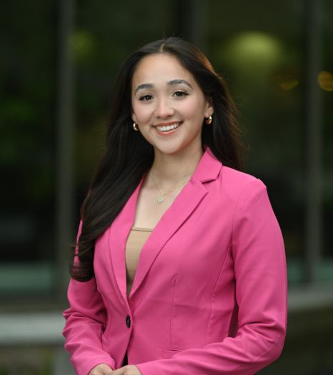
Jocelyn Ramirez
Dominican University

Slide 12
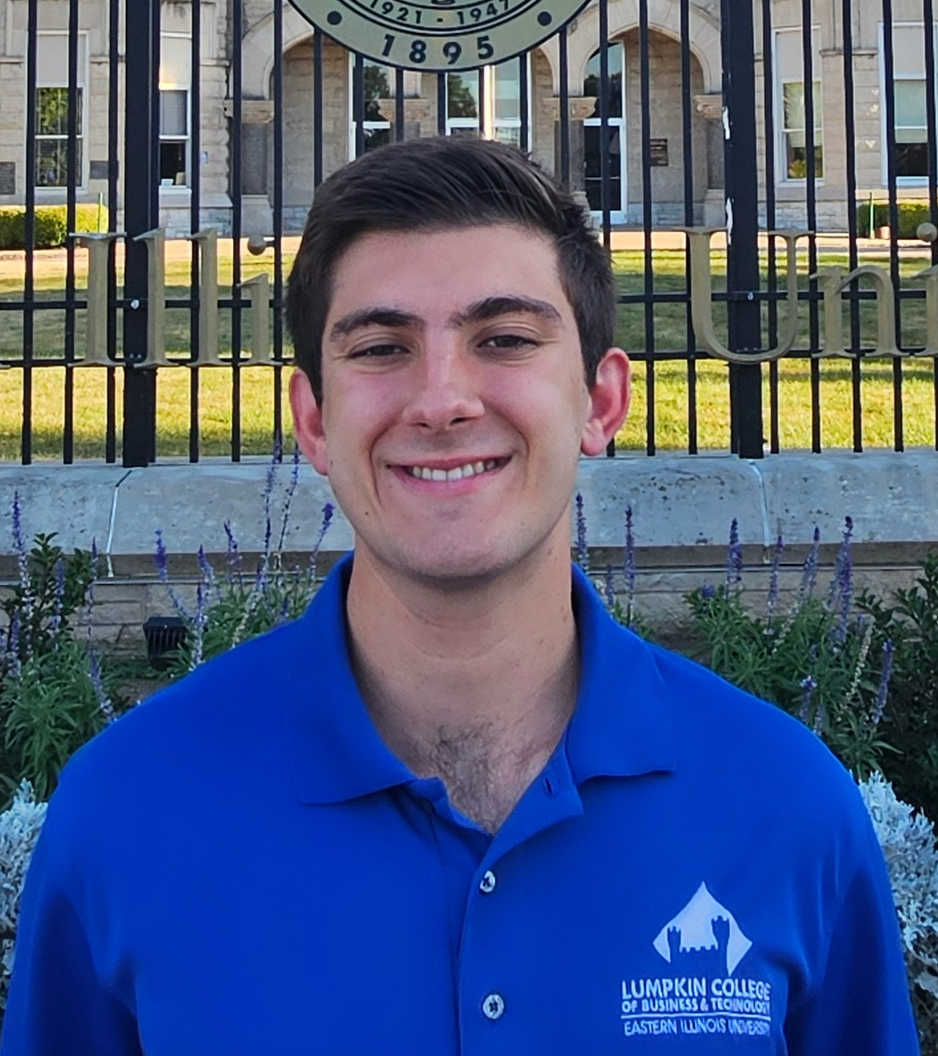
Alexander Morris Wilcoxon
Eastern Illinois University

Slide 13
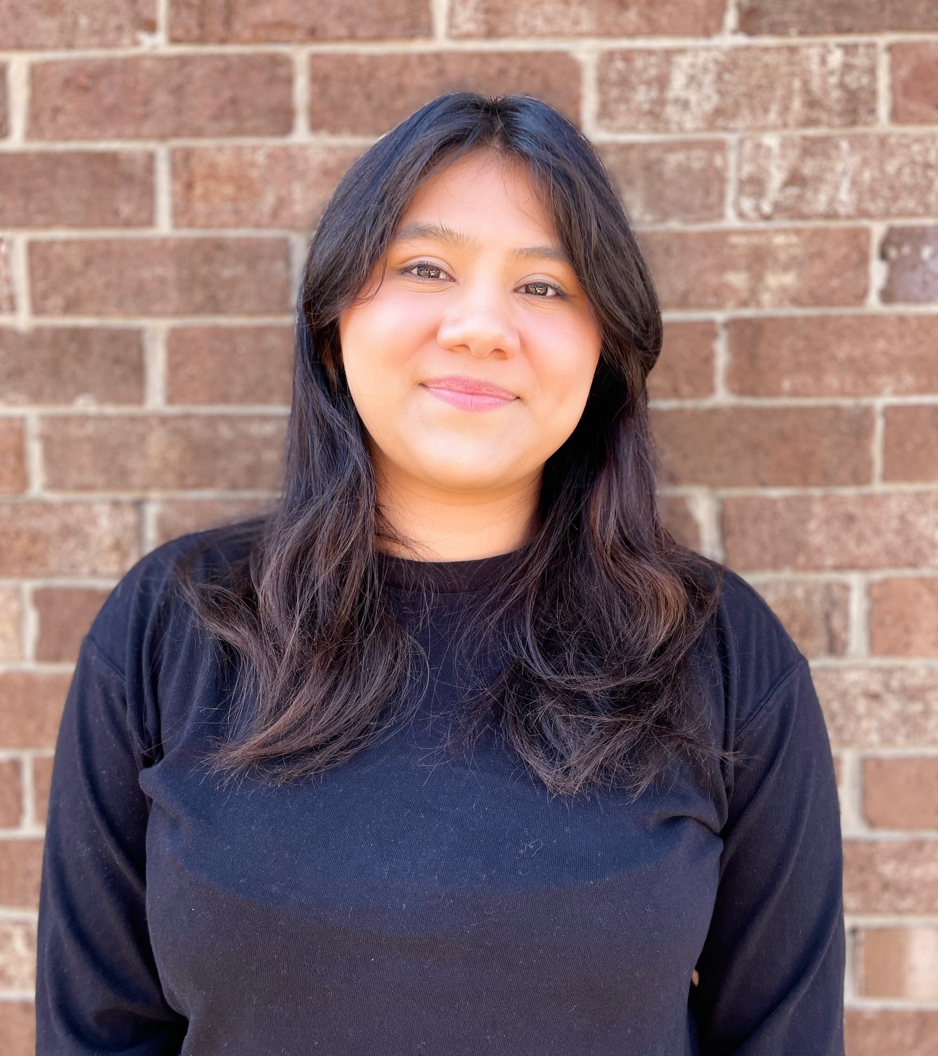
Yaquelin Martinez
East-West University

Slide 14
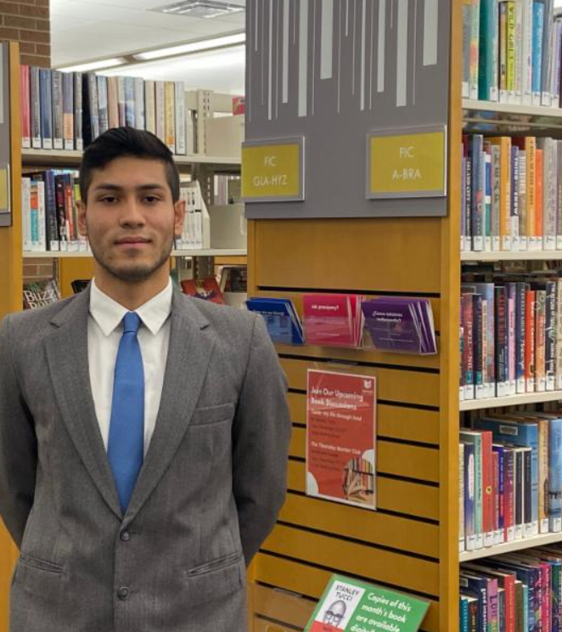
Mateo Gomez Bedoya
Elmhurst University

Slide 15
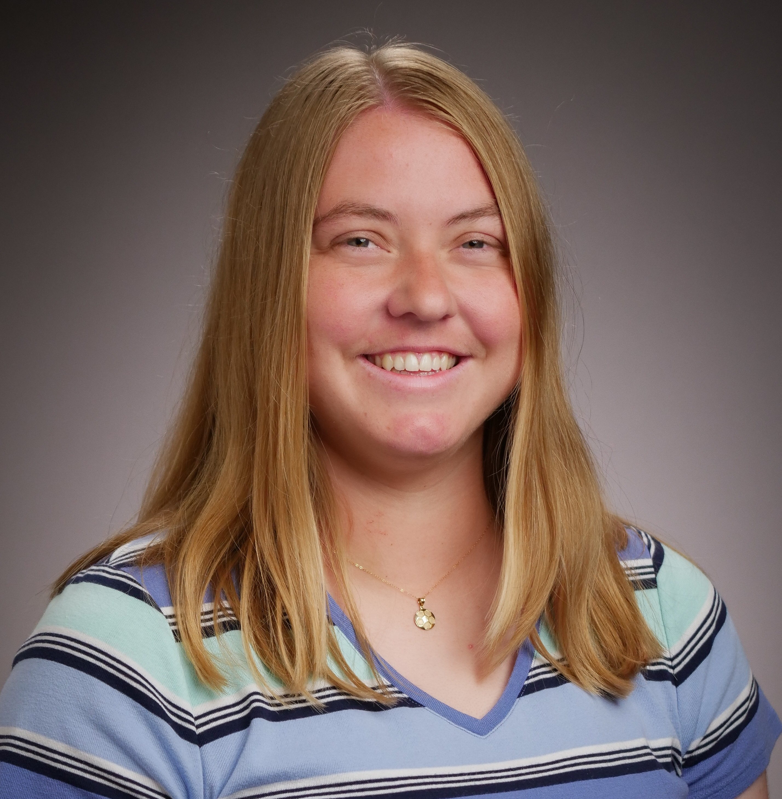
Kateland Diana Dearing
Williams
Eureka College

Slide 16
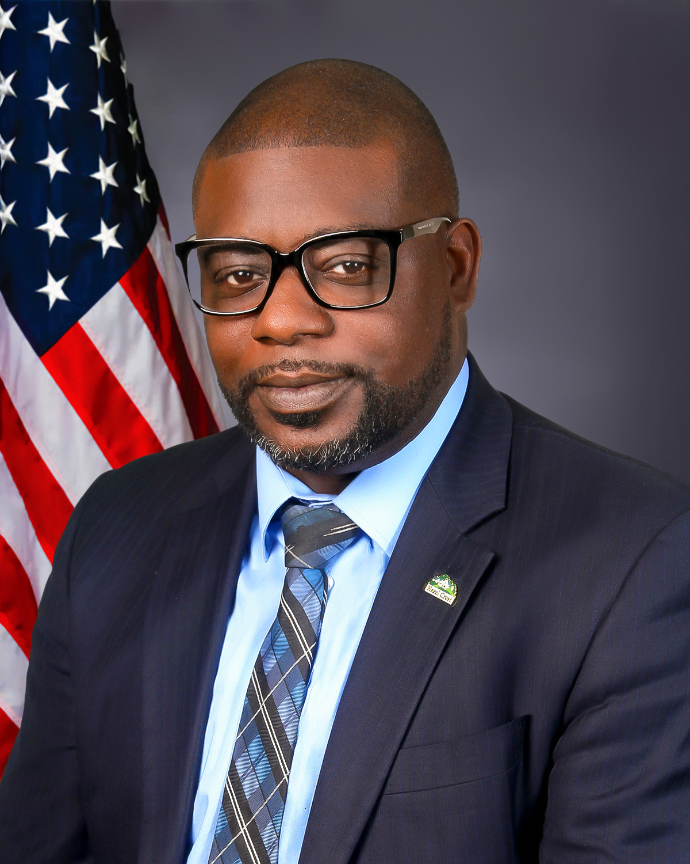
Jonathan LaSean Cooper
Governors State University

Slide 17
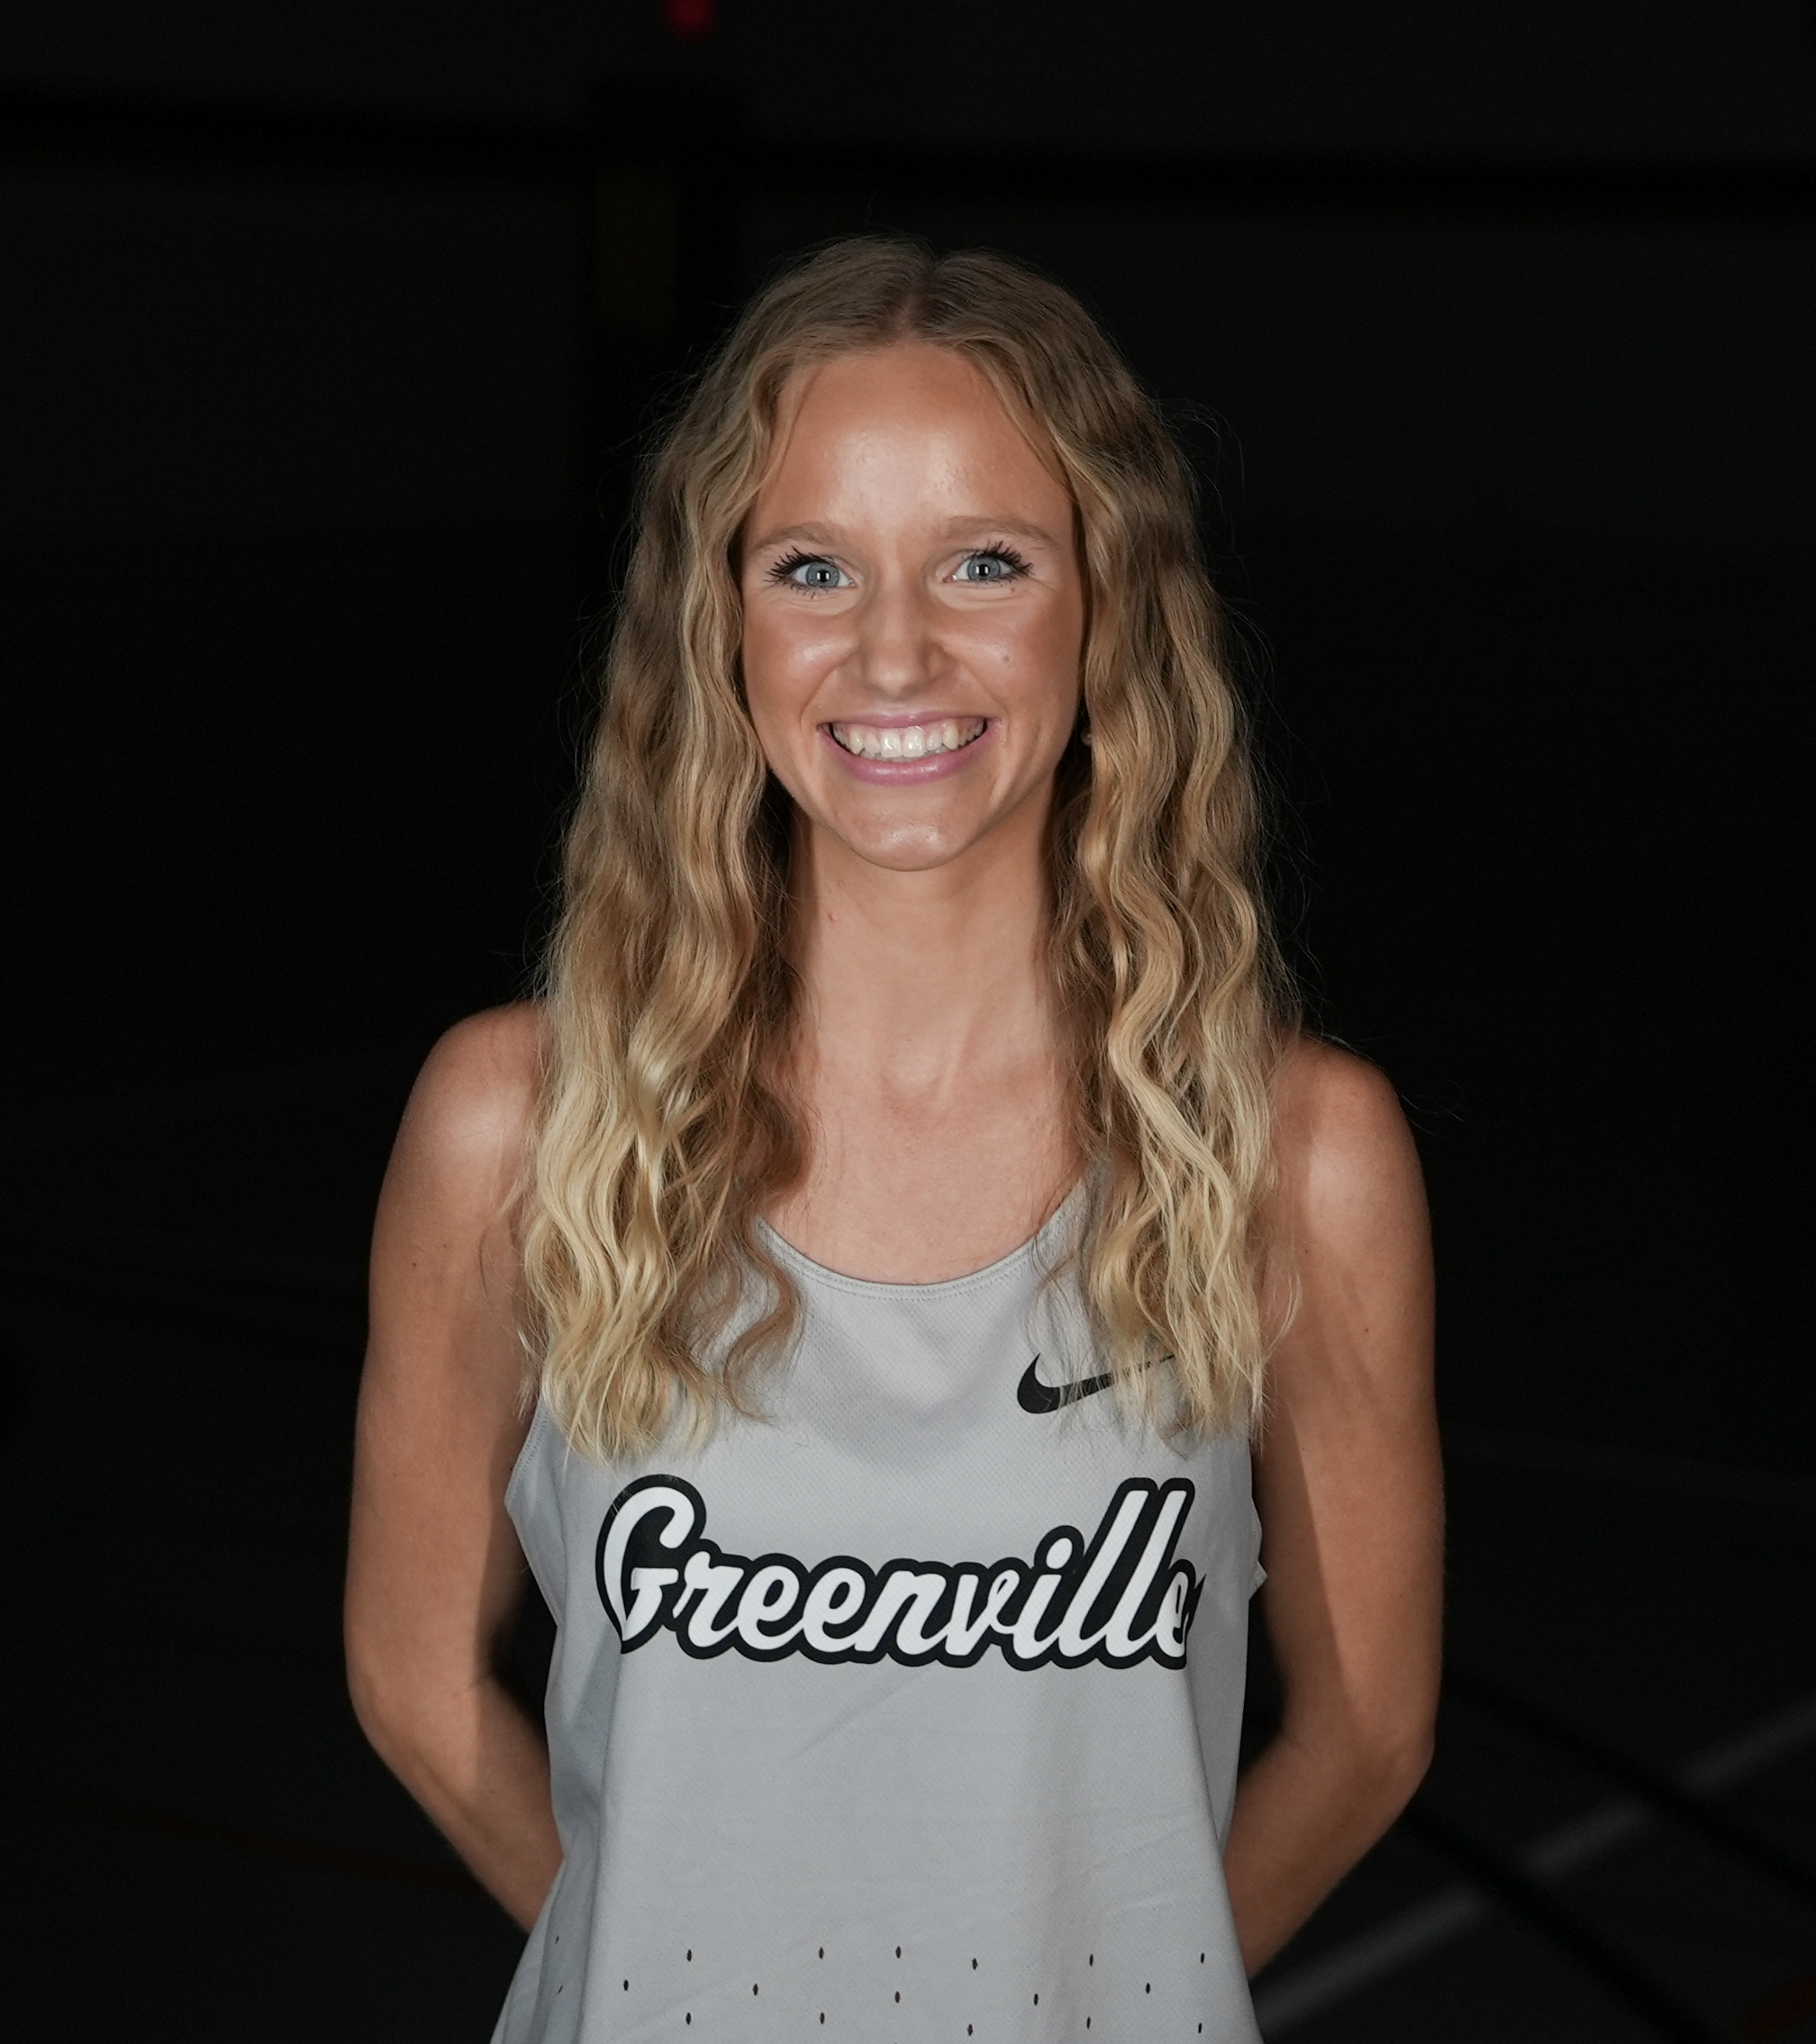
Norah Rae Swinigan Atkins
Greenville University

Slide 18
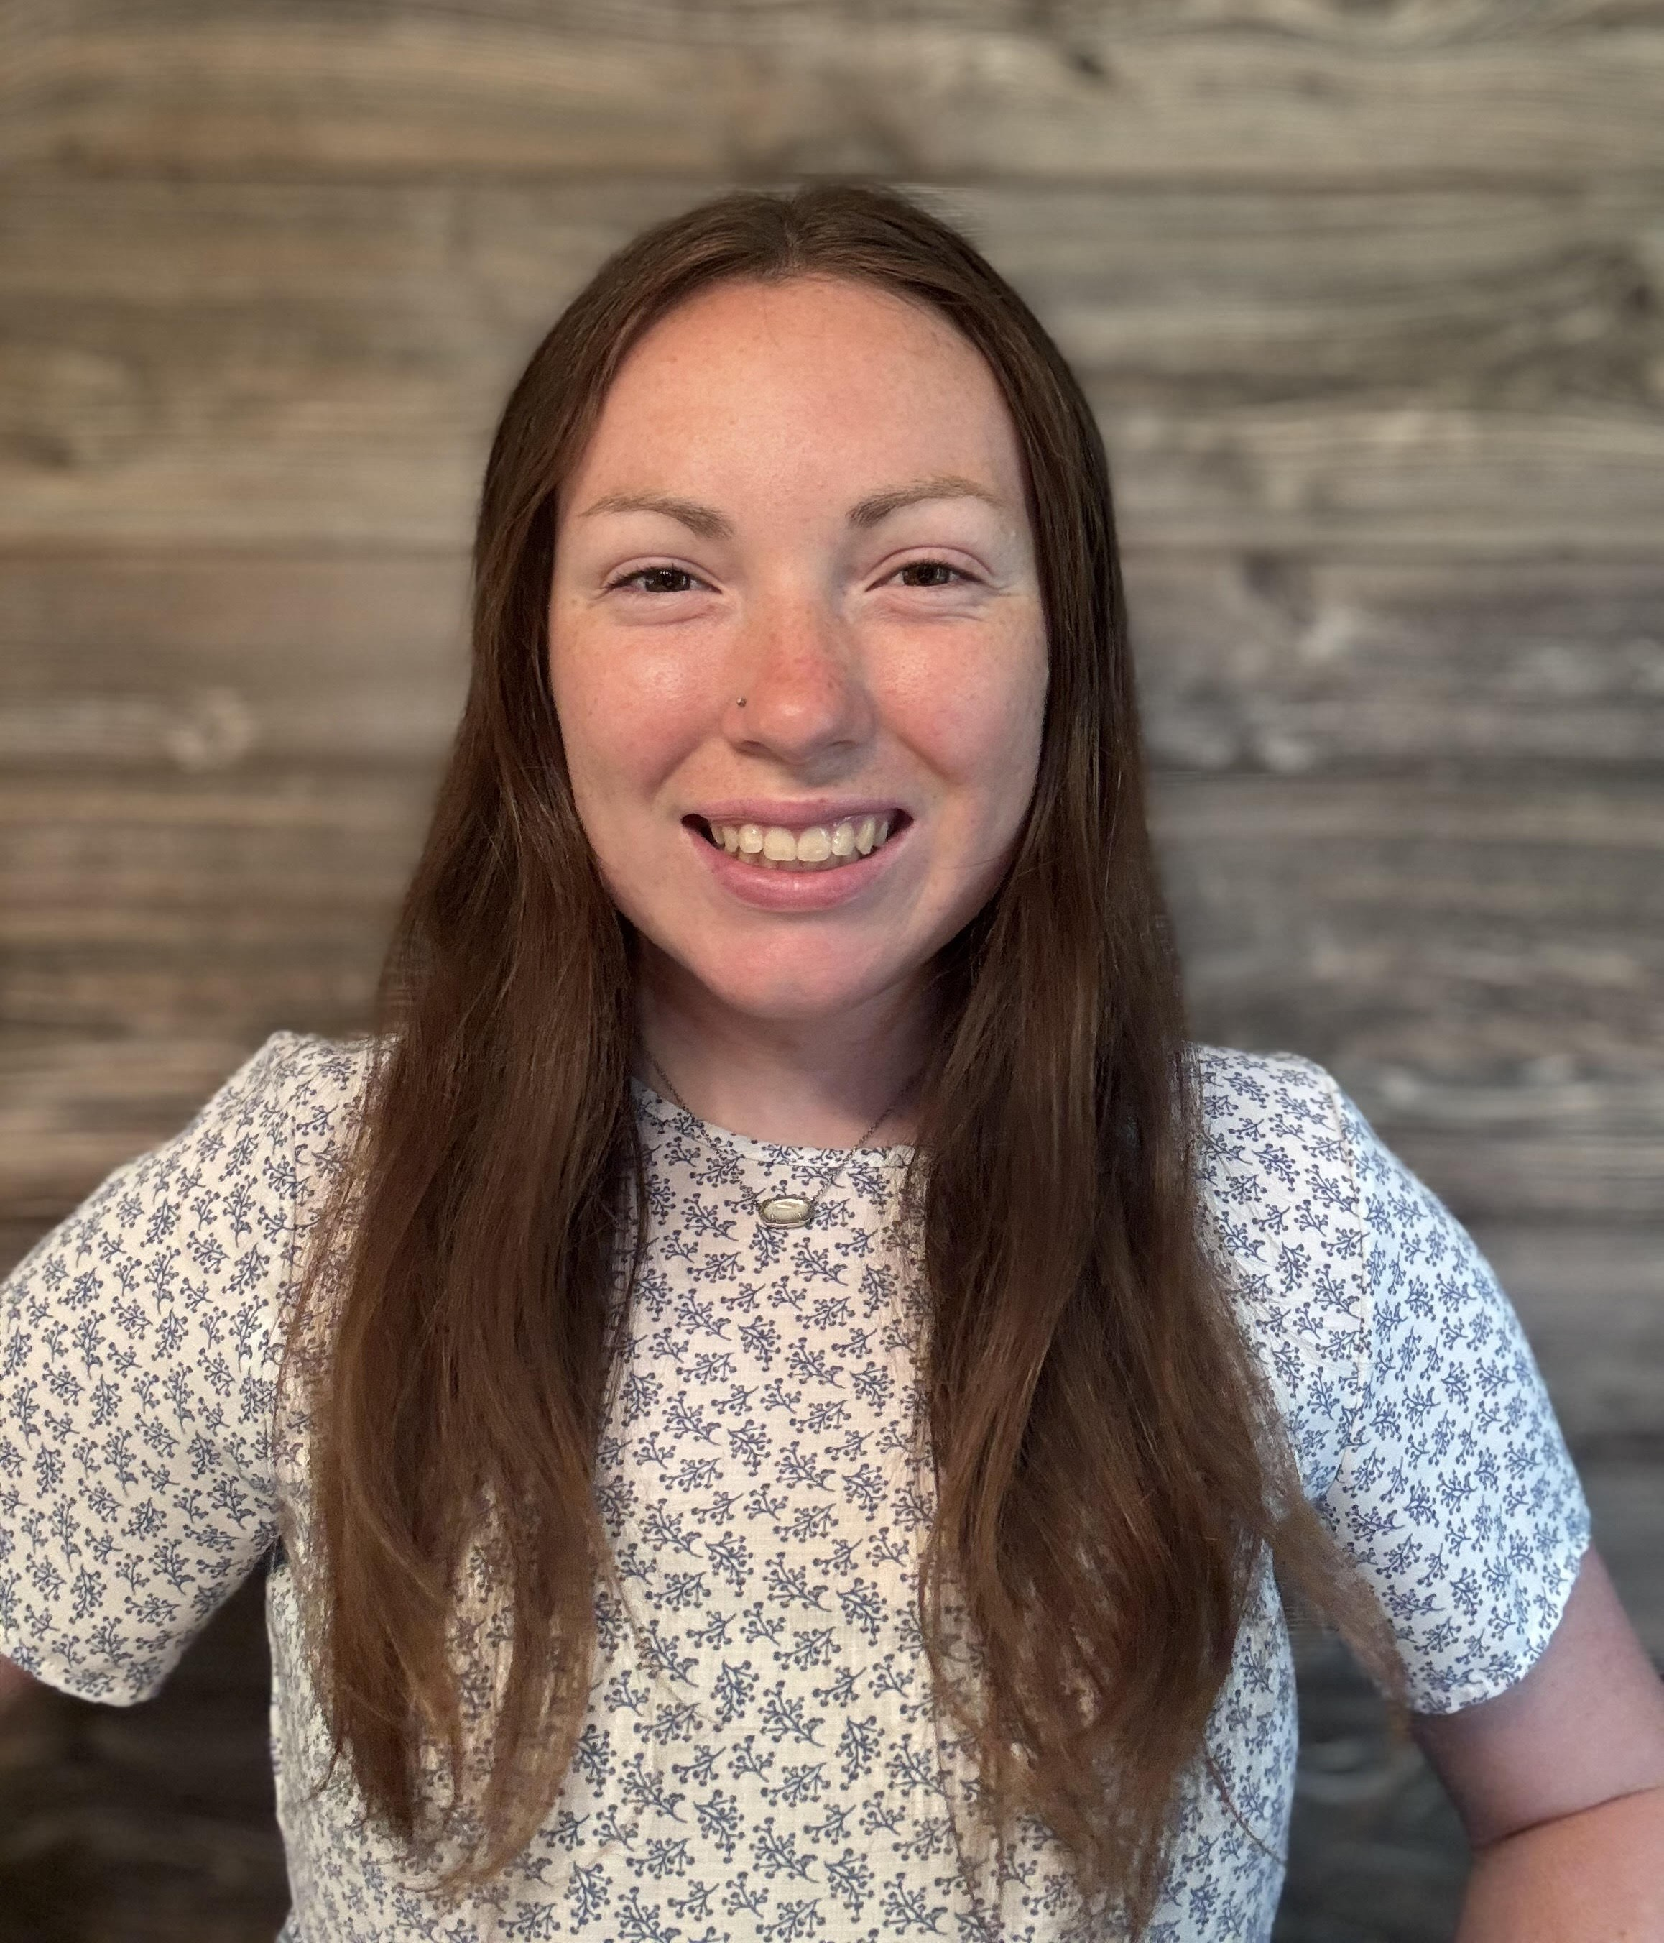
Emily Guest
Illinois College

Slide 19
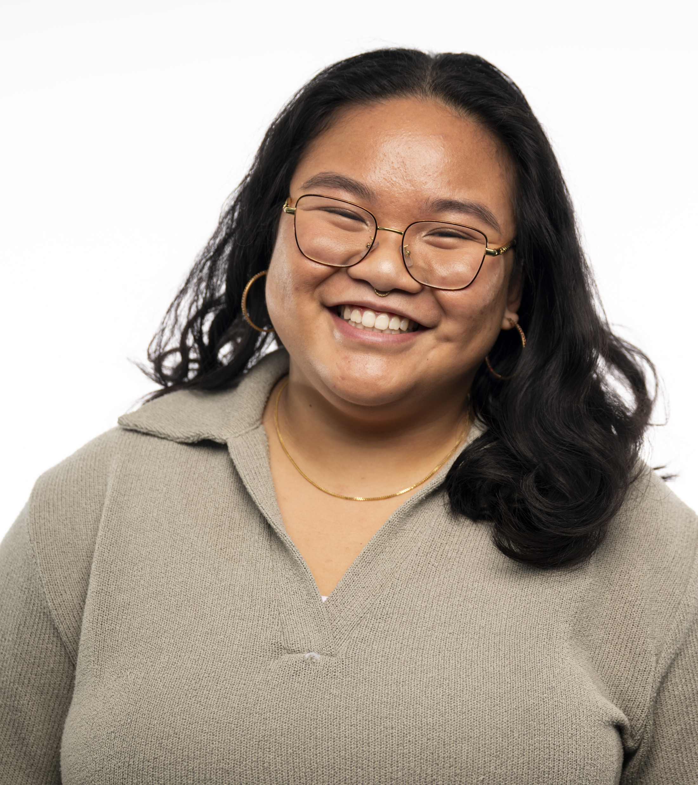
Genna Gaitan
Illinois Institute of Technology

Slide 20
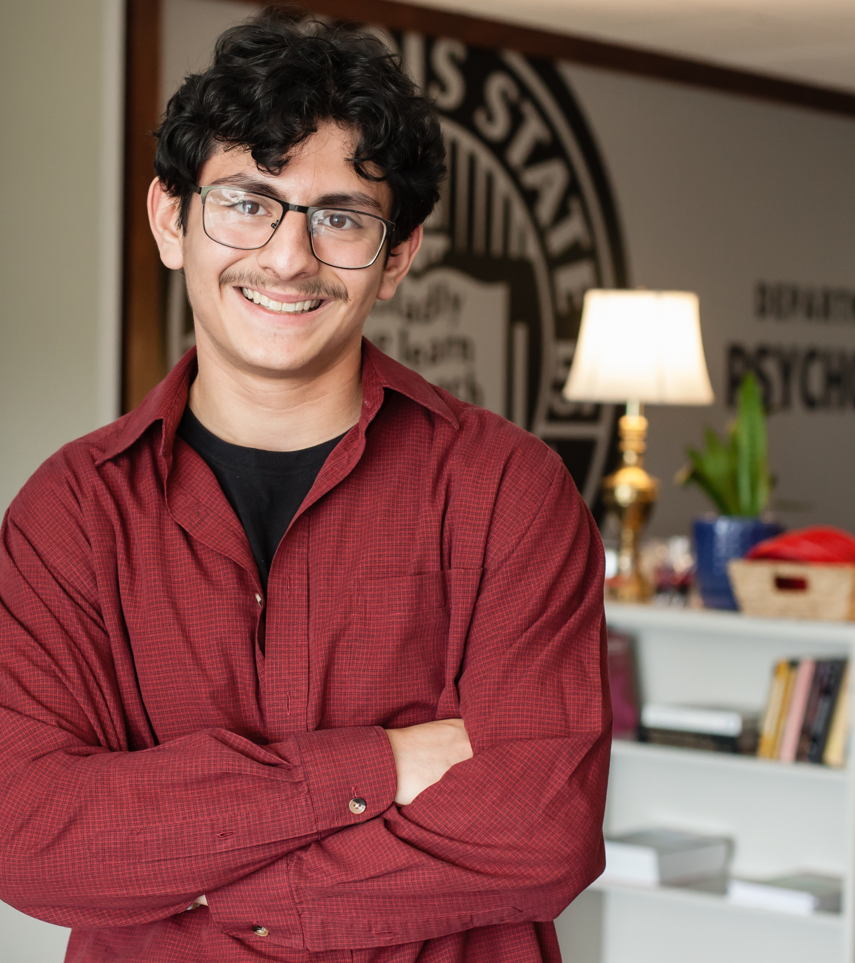
Kruz E. Barrera
Illinois State University

Slide 21
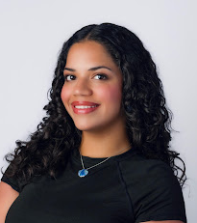
Valeria Suarez
Illinois Wesleyan University

Slide 22
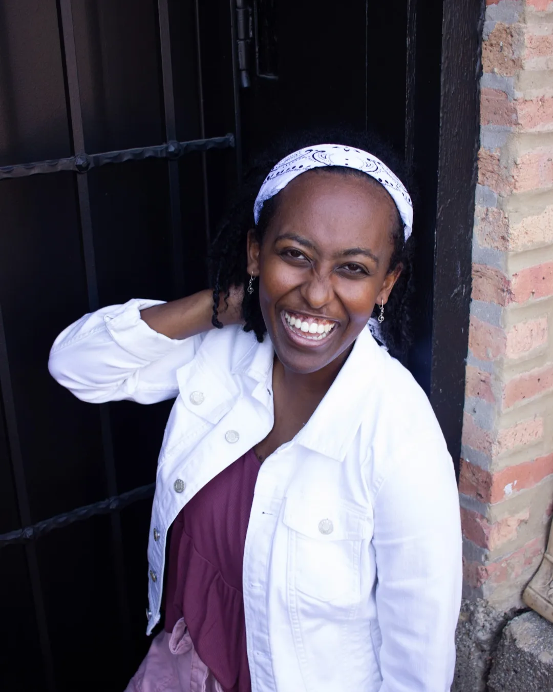
Hana Marie Cunningham
Judson University

Slide 23
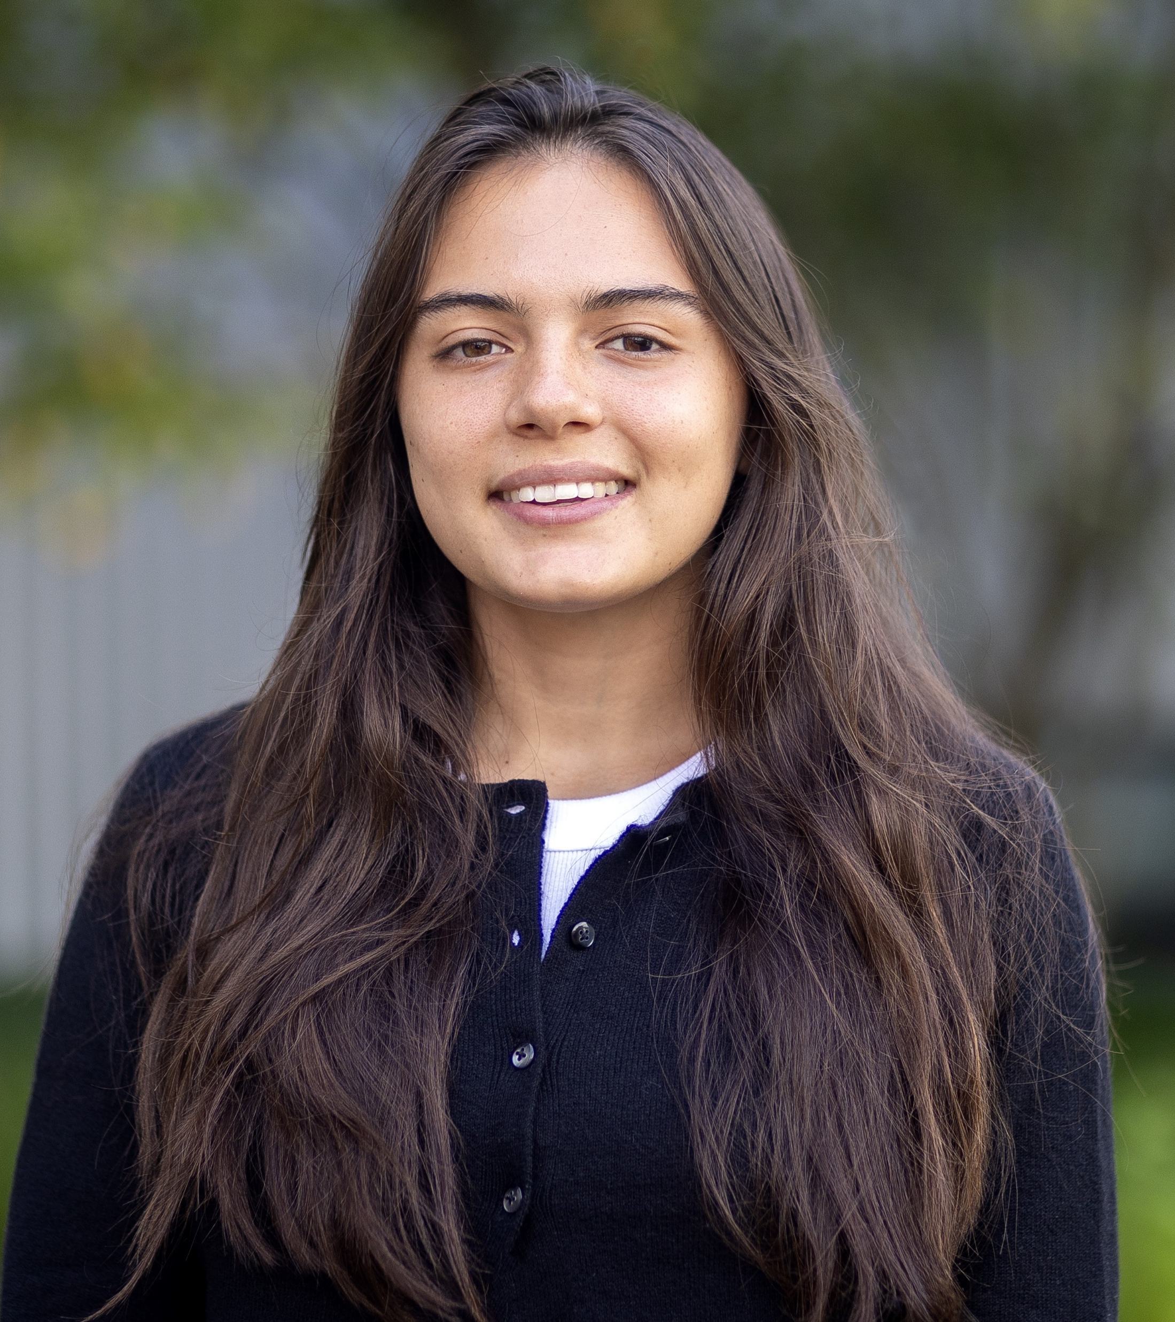
Zoe Araceli Pav
Knox College

Slide 24
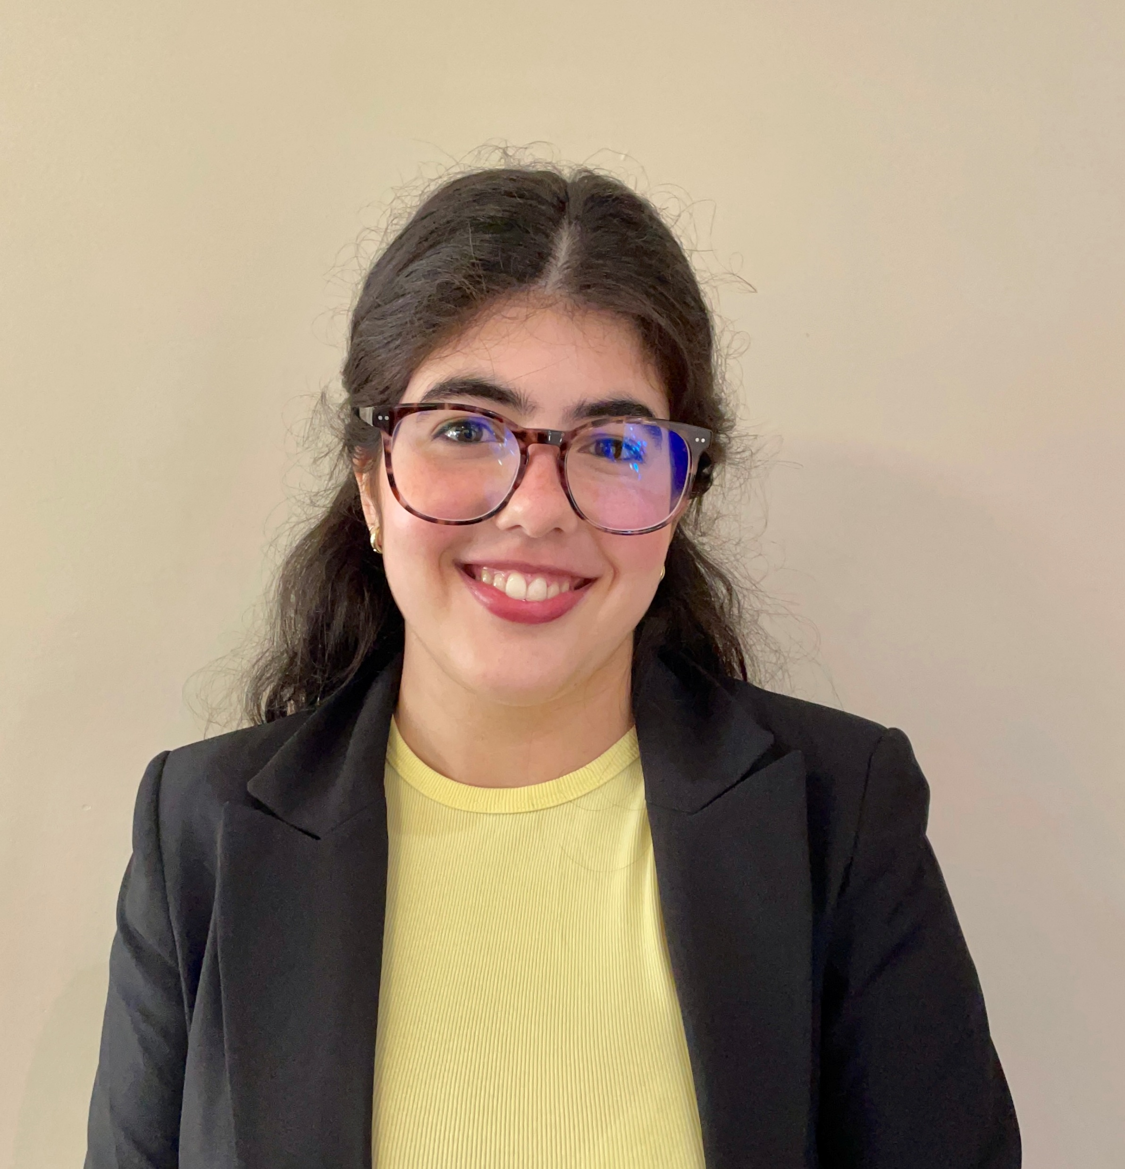
Emilia Guilhermina de Paula Fonseca
Lake Forest College

Slide 25
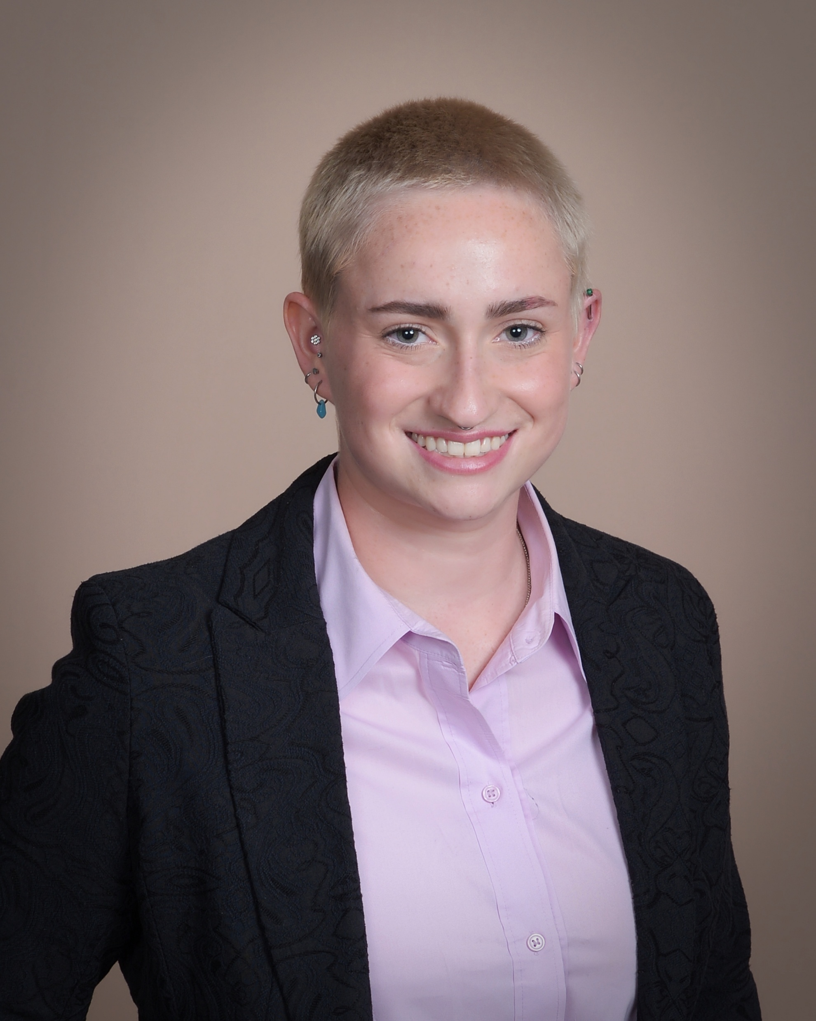
Aletheia Johnson
Lewis University

Slide 26
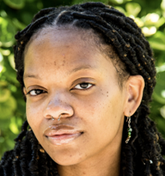
Amelie Malone
Loyola University Chicago

Slide 27
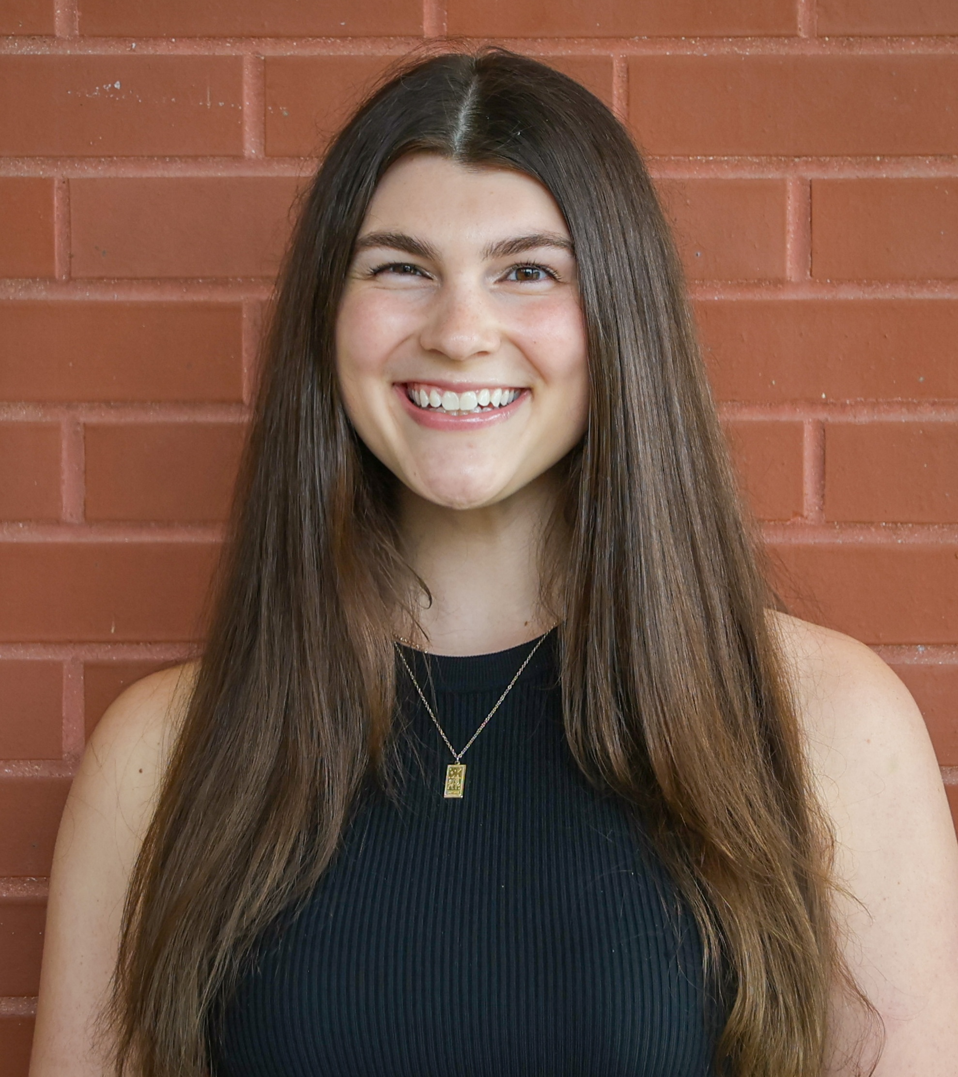
MaryAnn Romagna
McKendree University

Slide 28
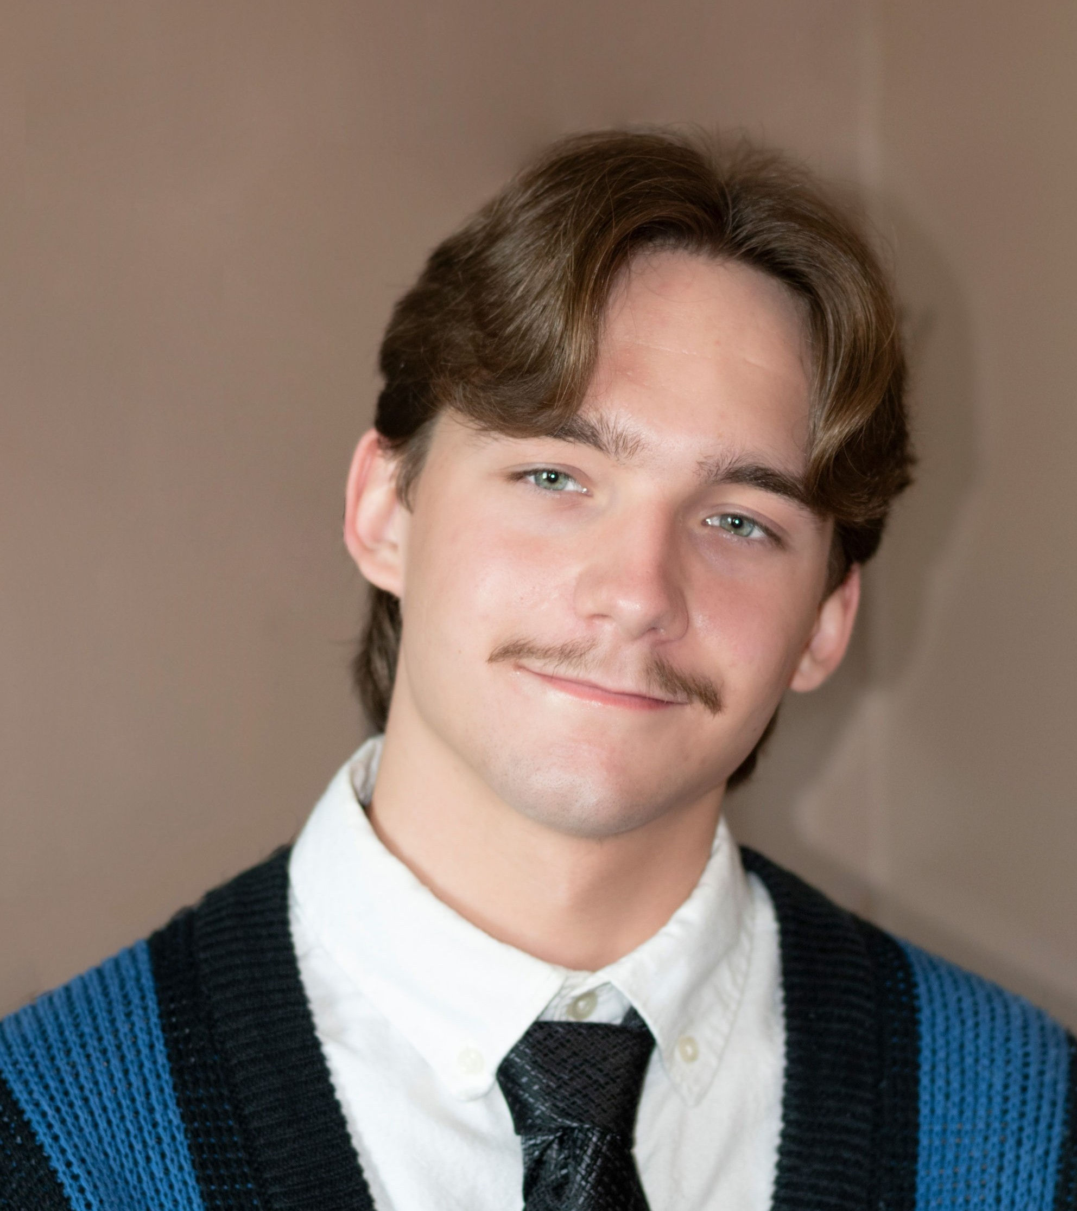
Alex Joshua Lee Farkasch
Millikin University

Slide 29
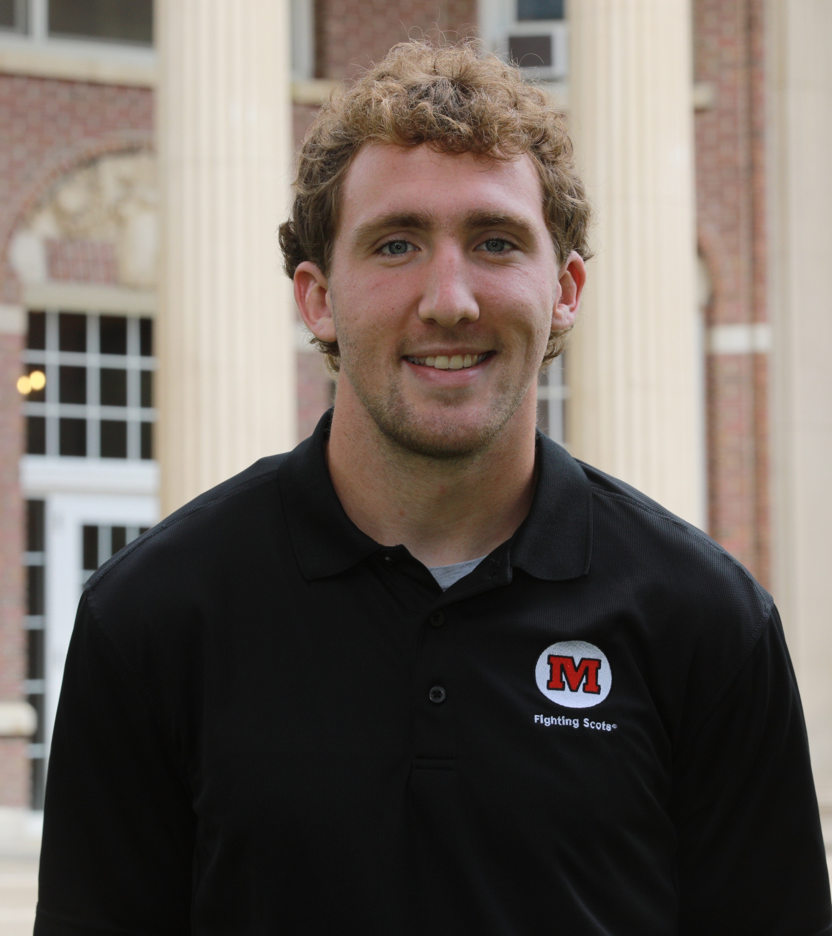
Turner William Plumer
Monmouth University

Slide 30
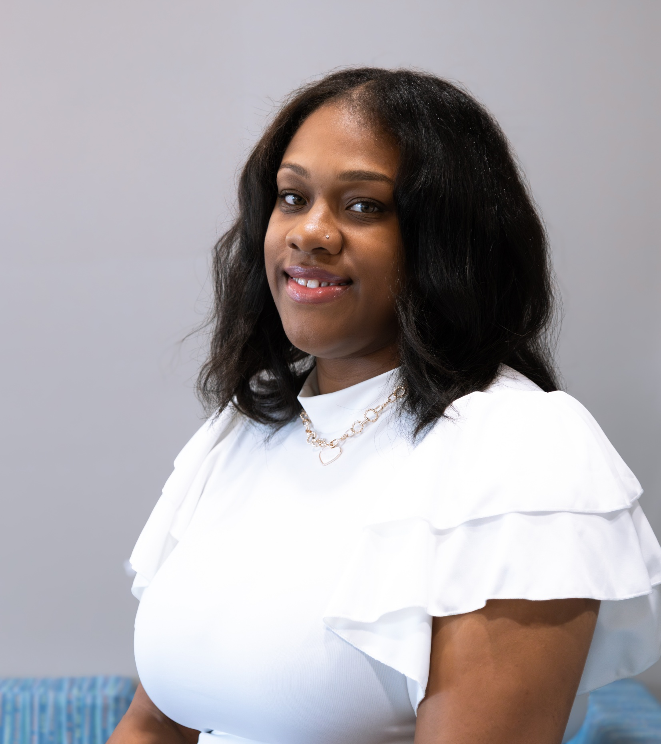
Kayla L. Shavers
National Louis University

Slide 31
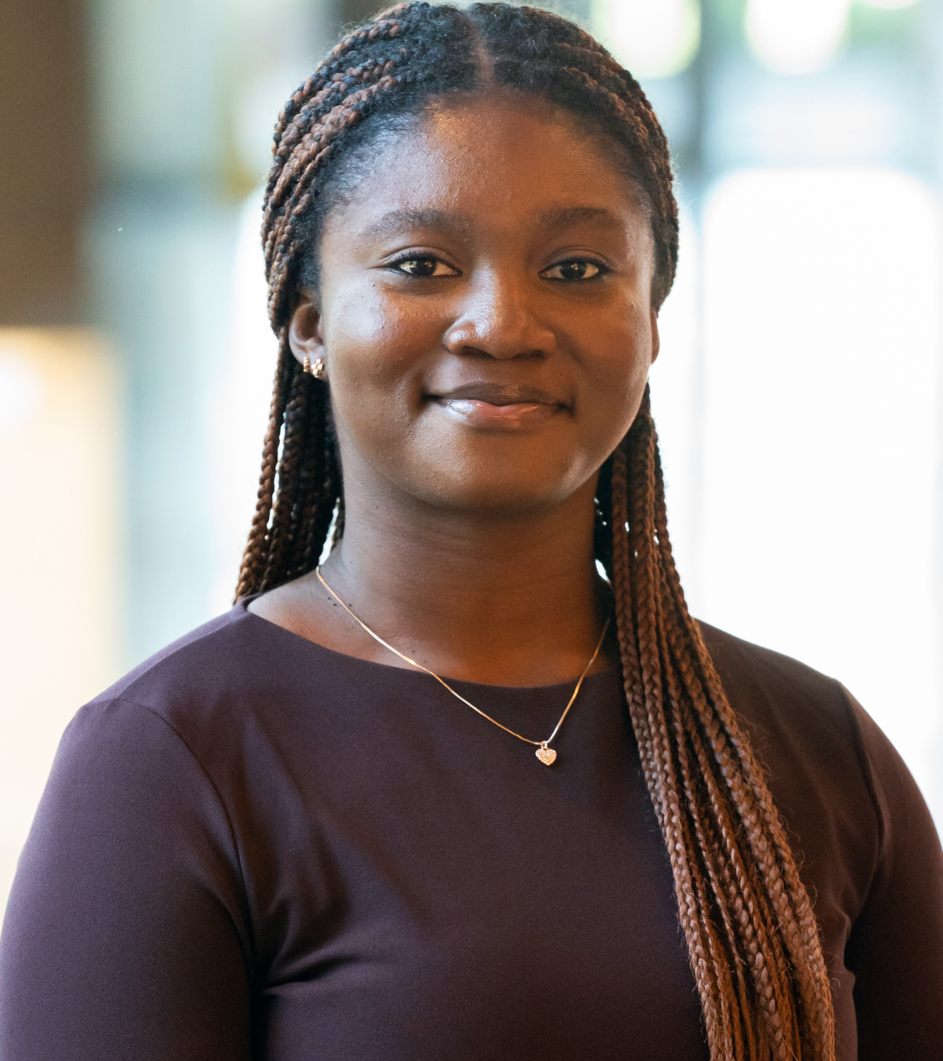
Nmesoma E. Onyejekwe
North Central University

Slide 32
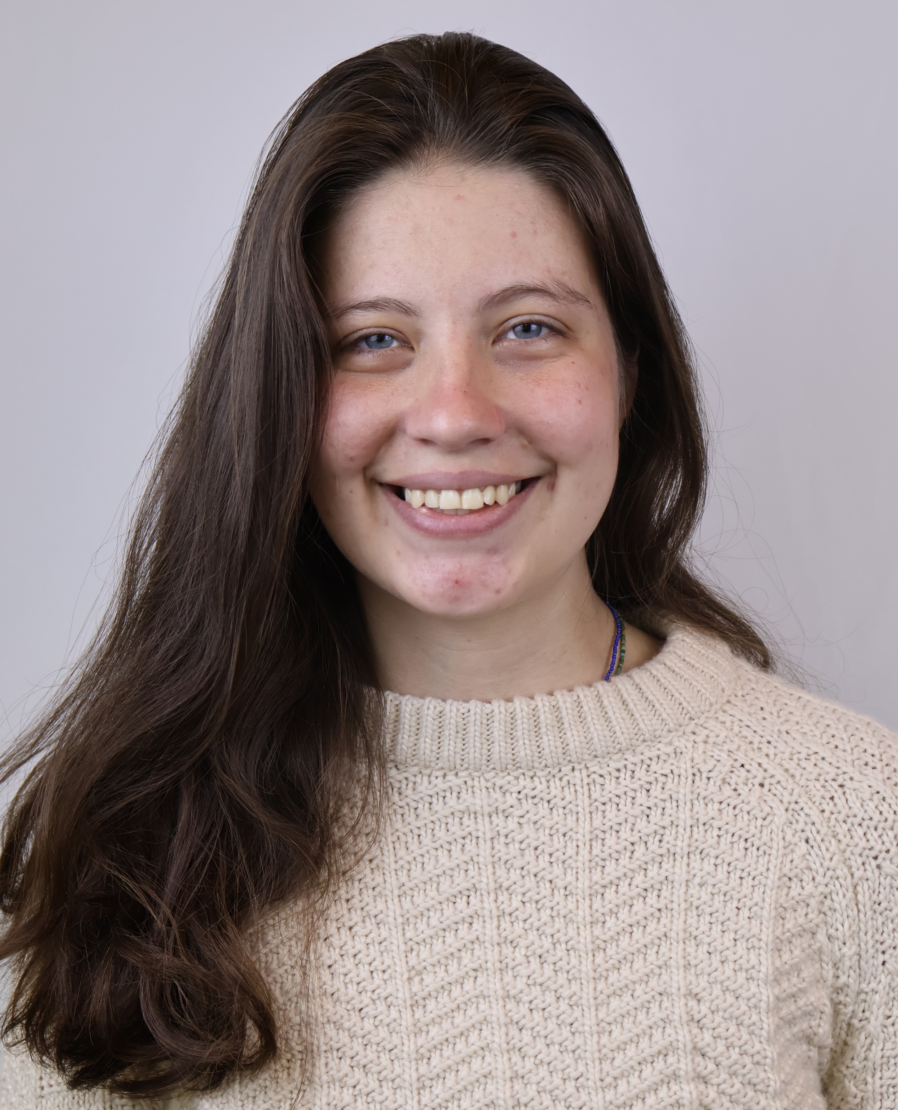
Sofia Grivot Volkmann
North Park University

Slide 33
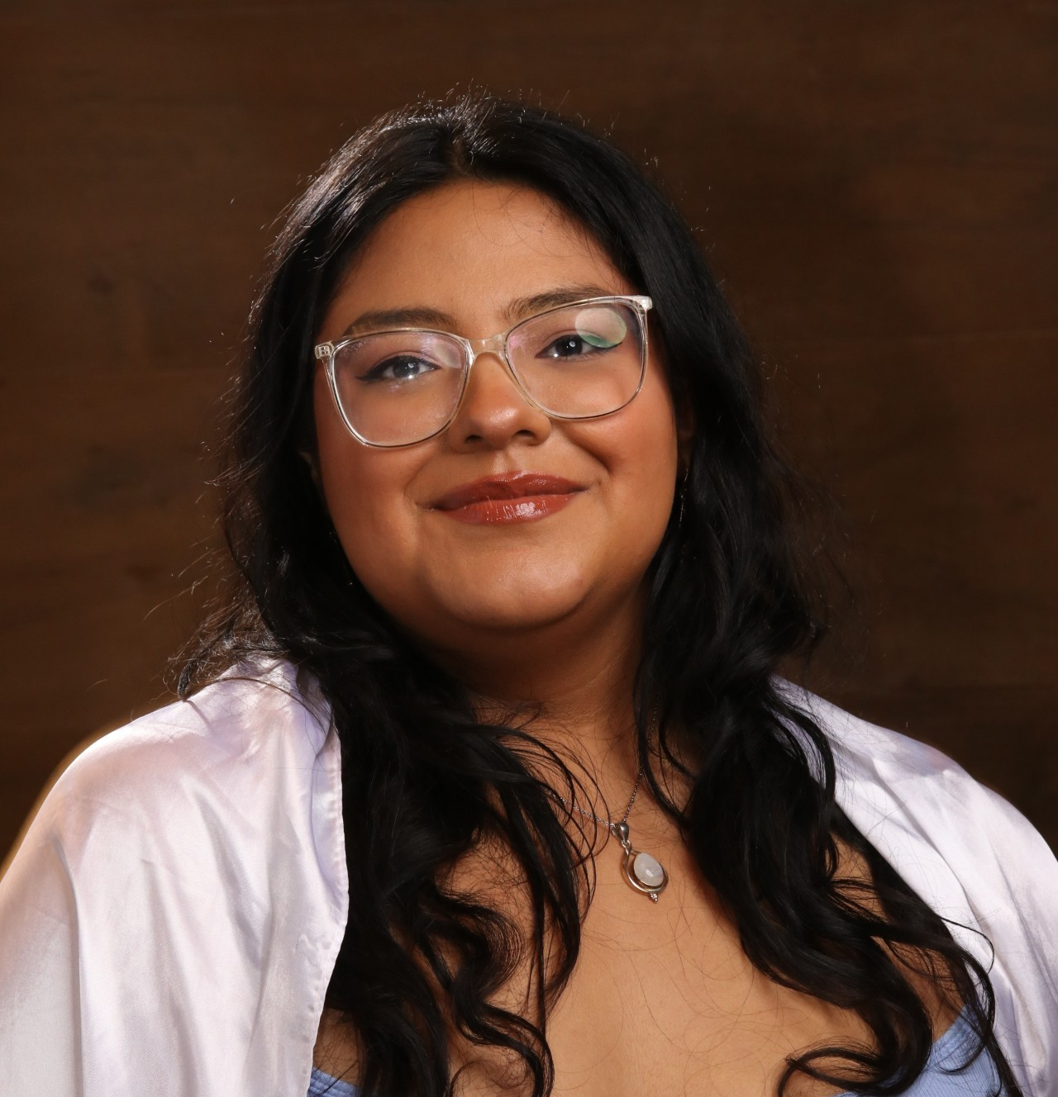
Cassaundra Garcia
Northeastern Illinois University

Slide 34
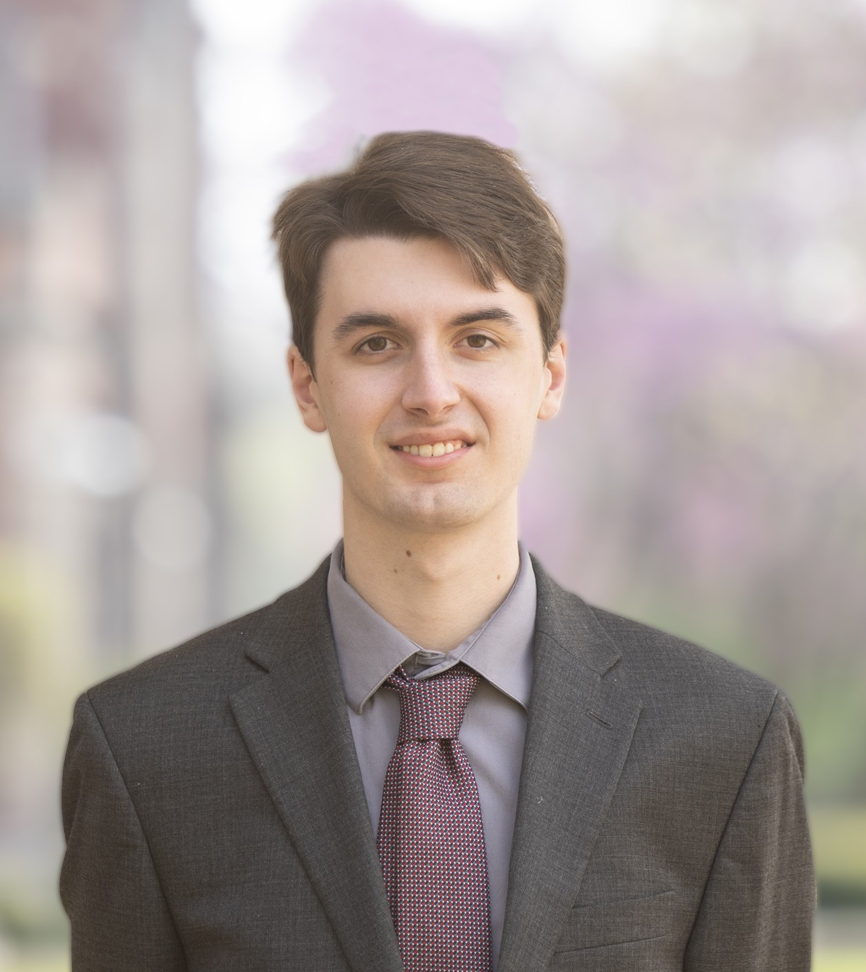
Joseph C. La Barbera
Northern Illinois University

Slide 35
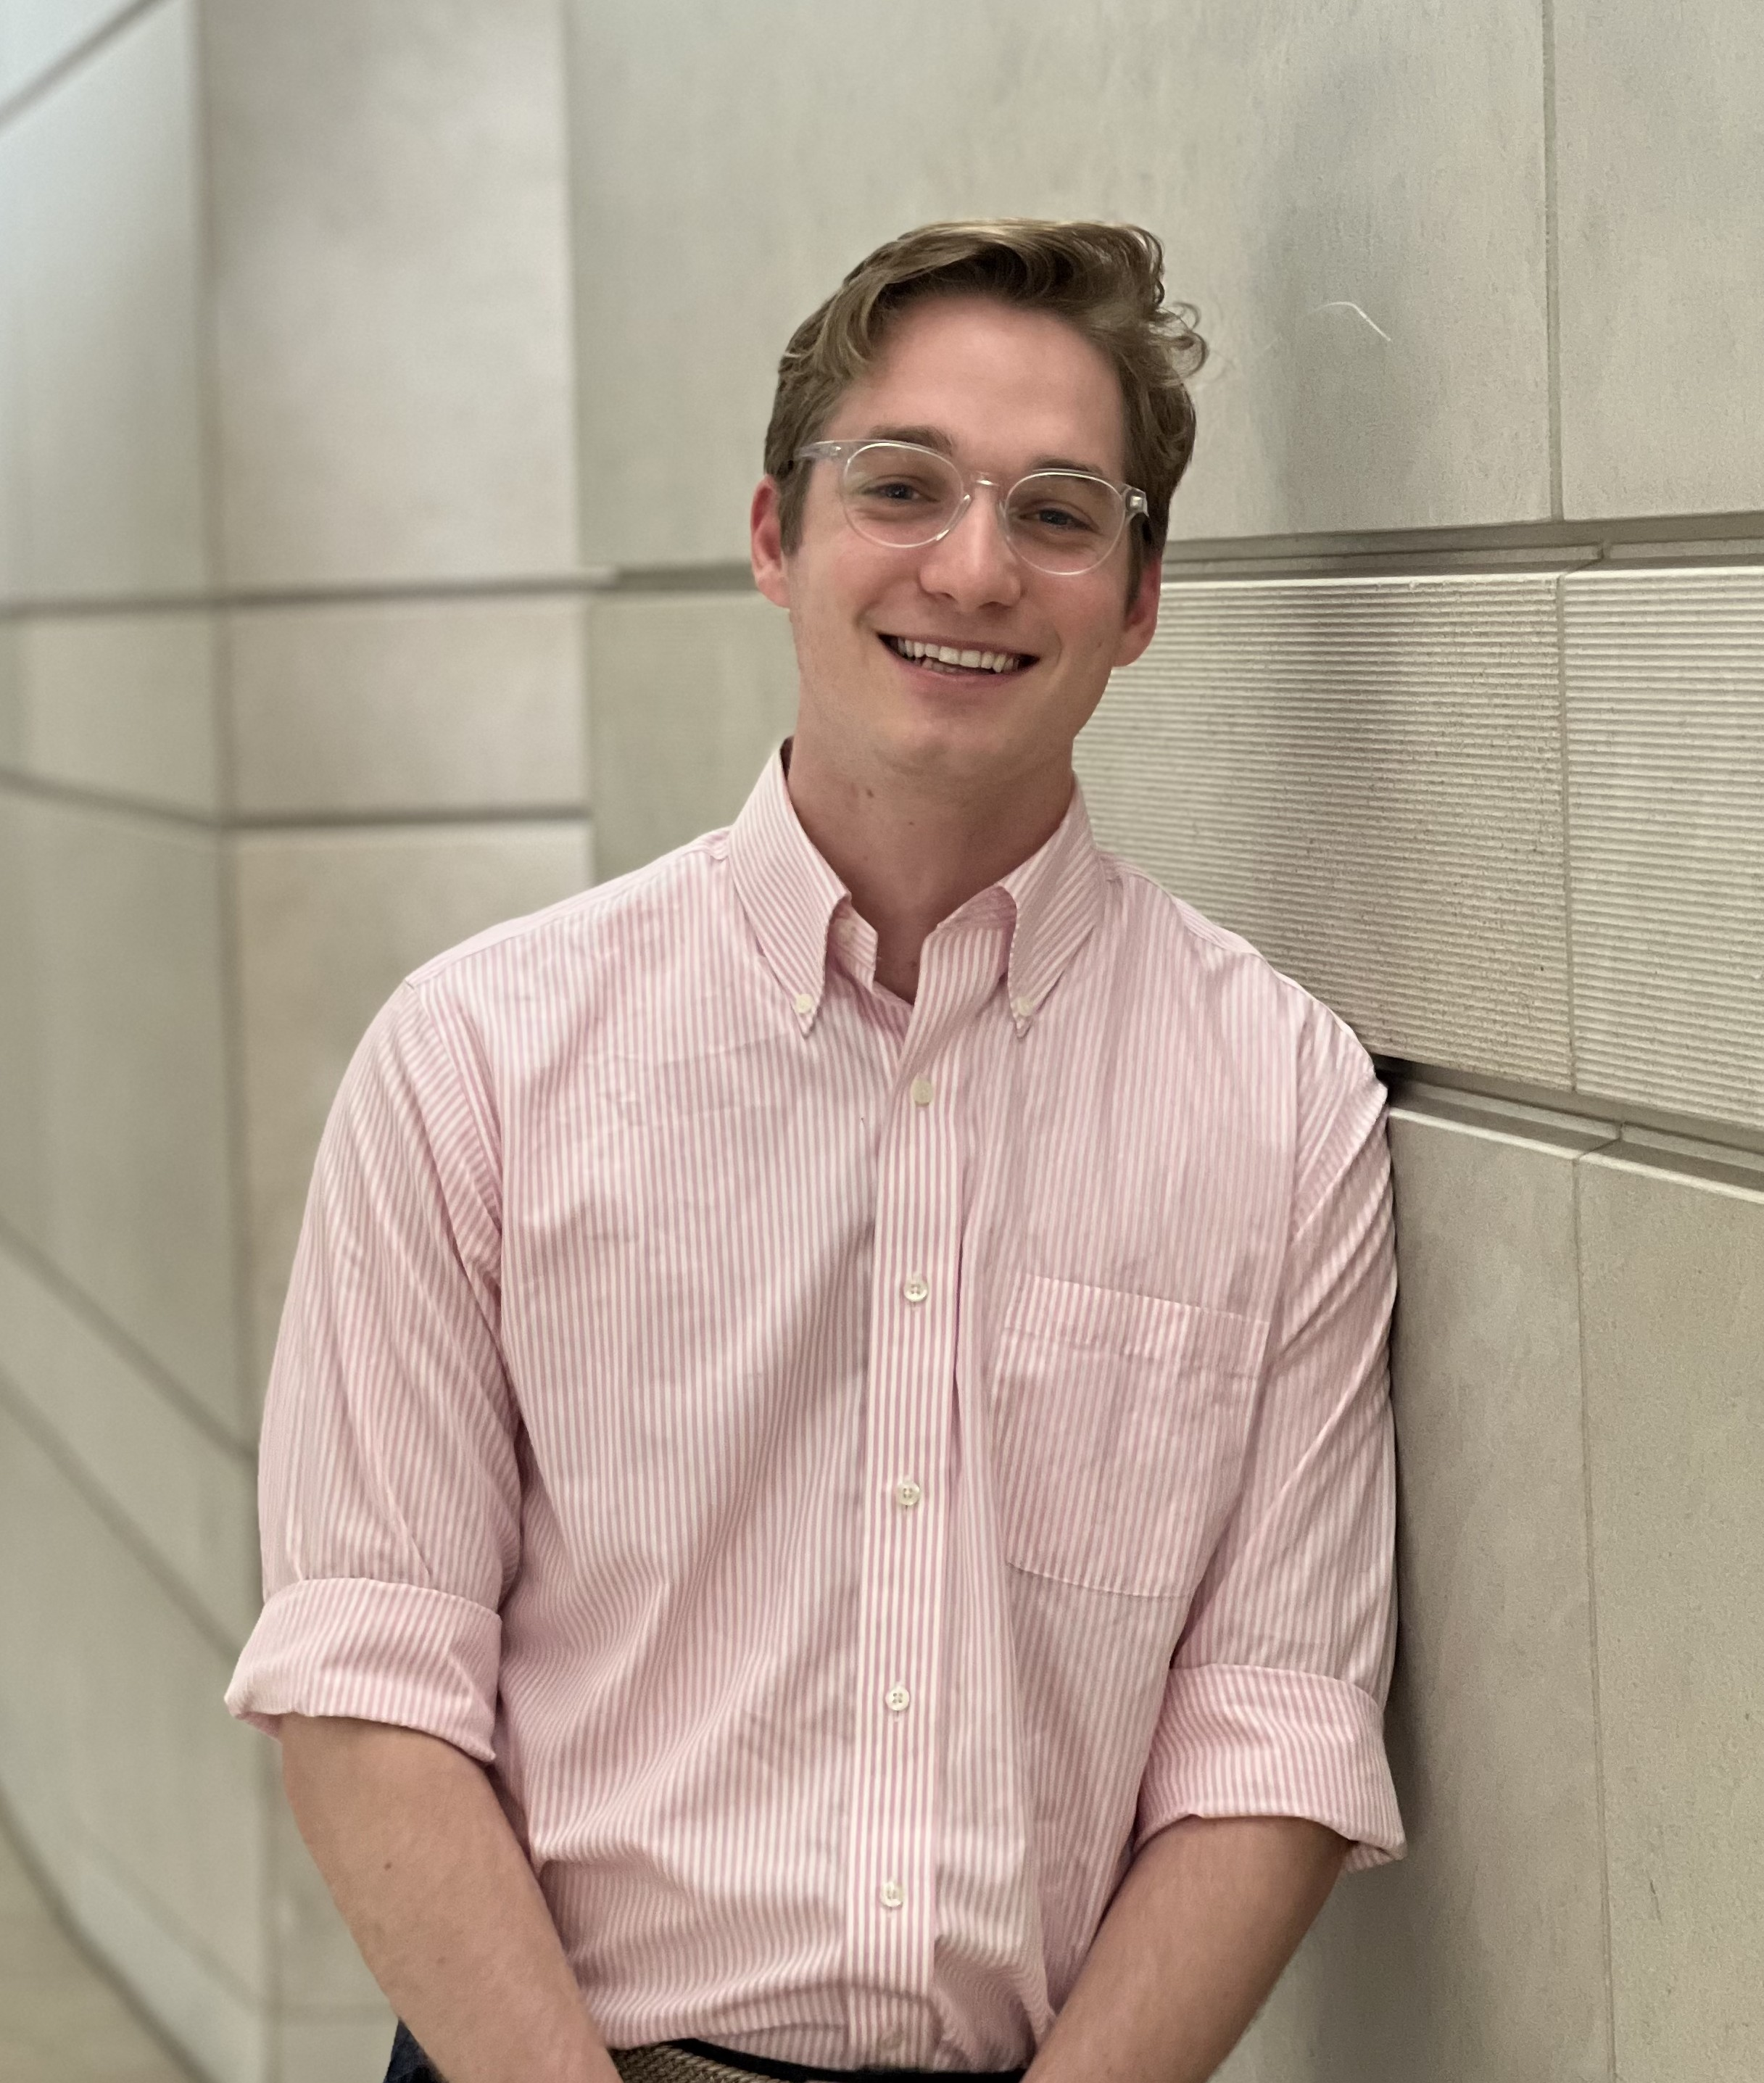
Christopher Axline
Northwestern University

Slide 36
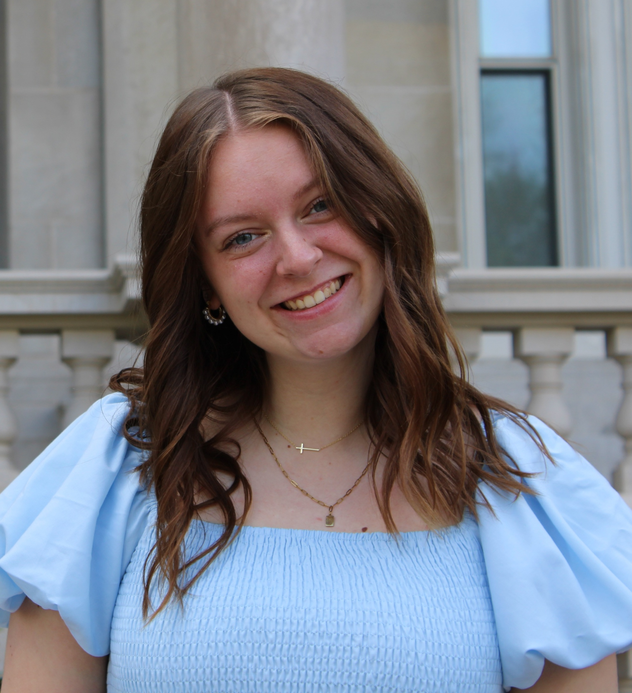
Grace Elizabeth Amburgey
Olivet Nazarene University

Slide 37
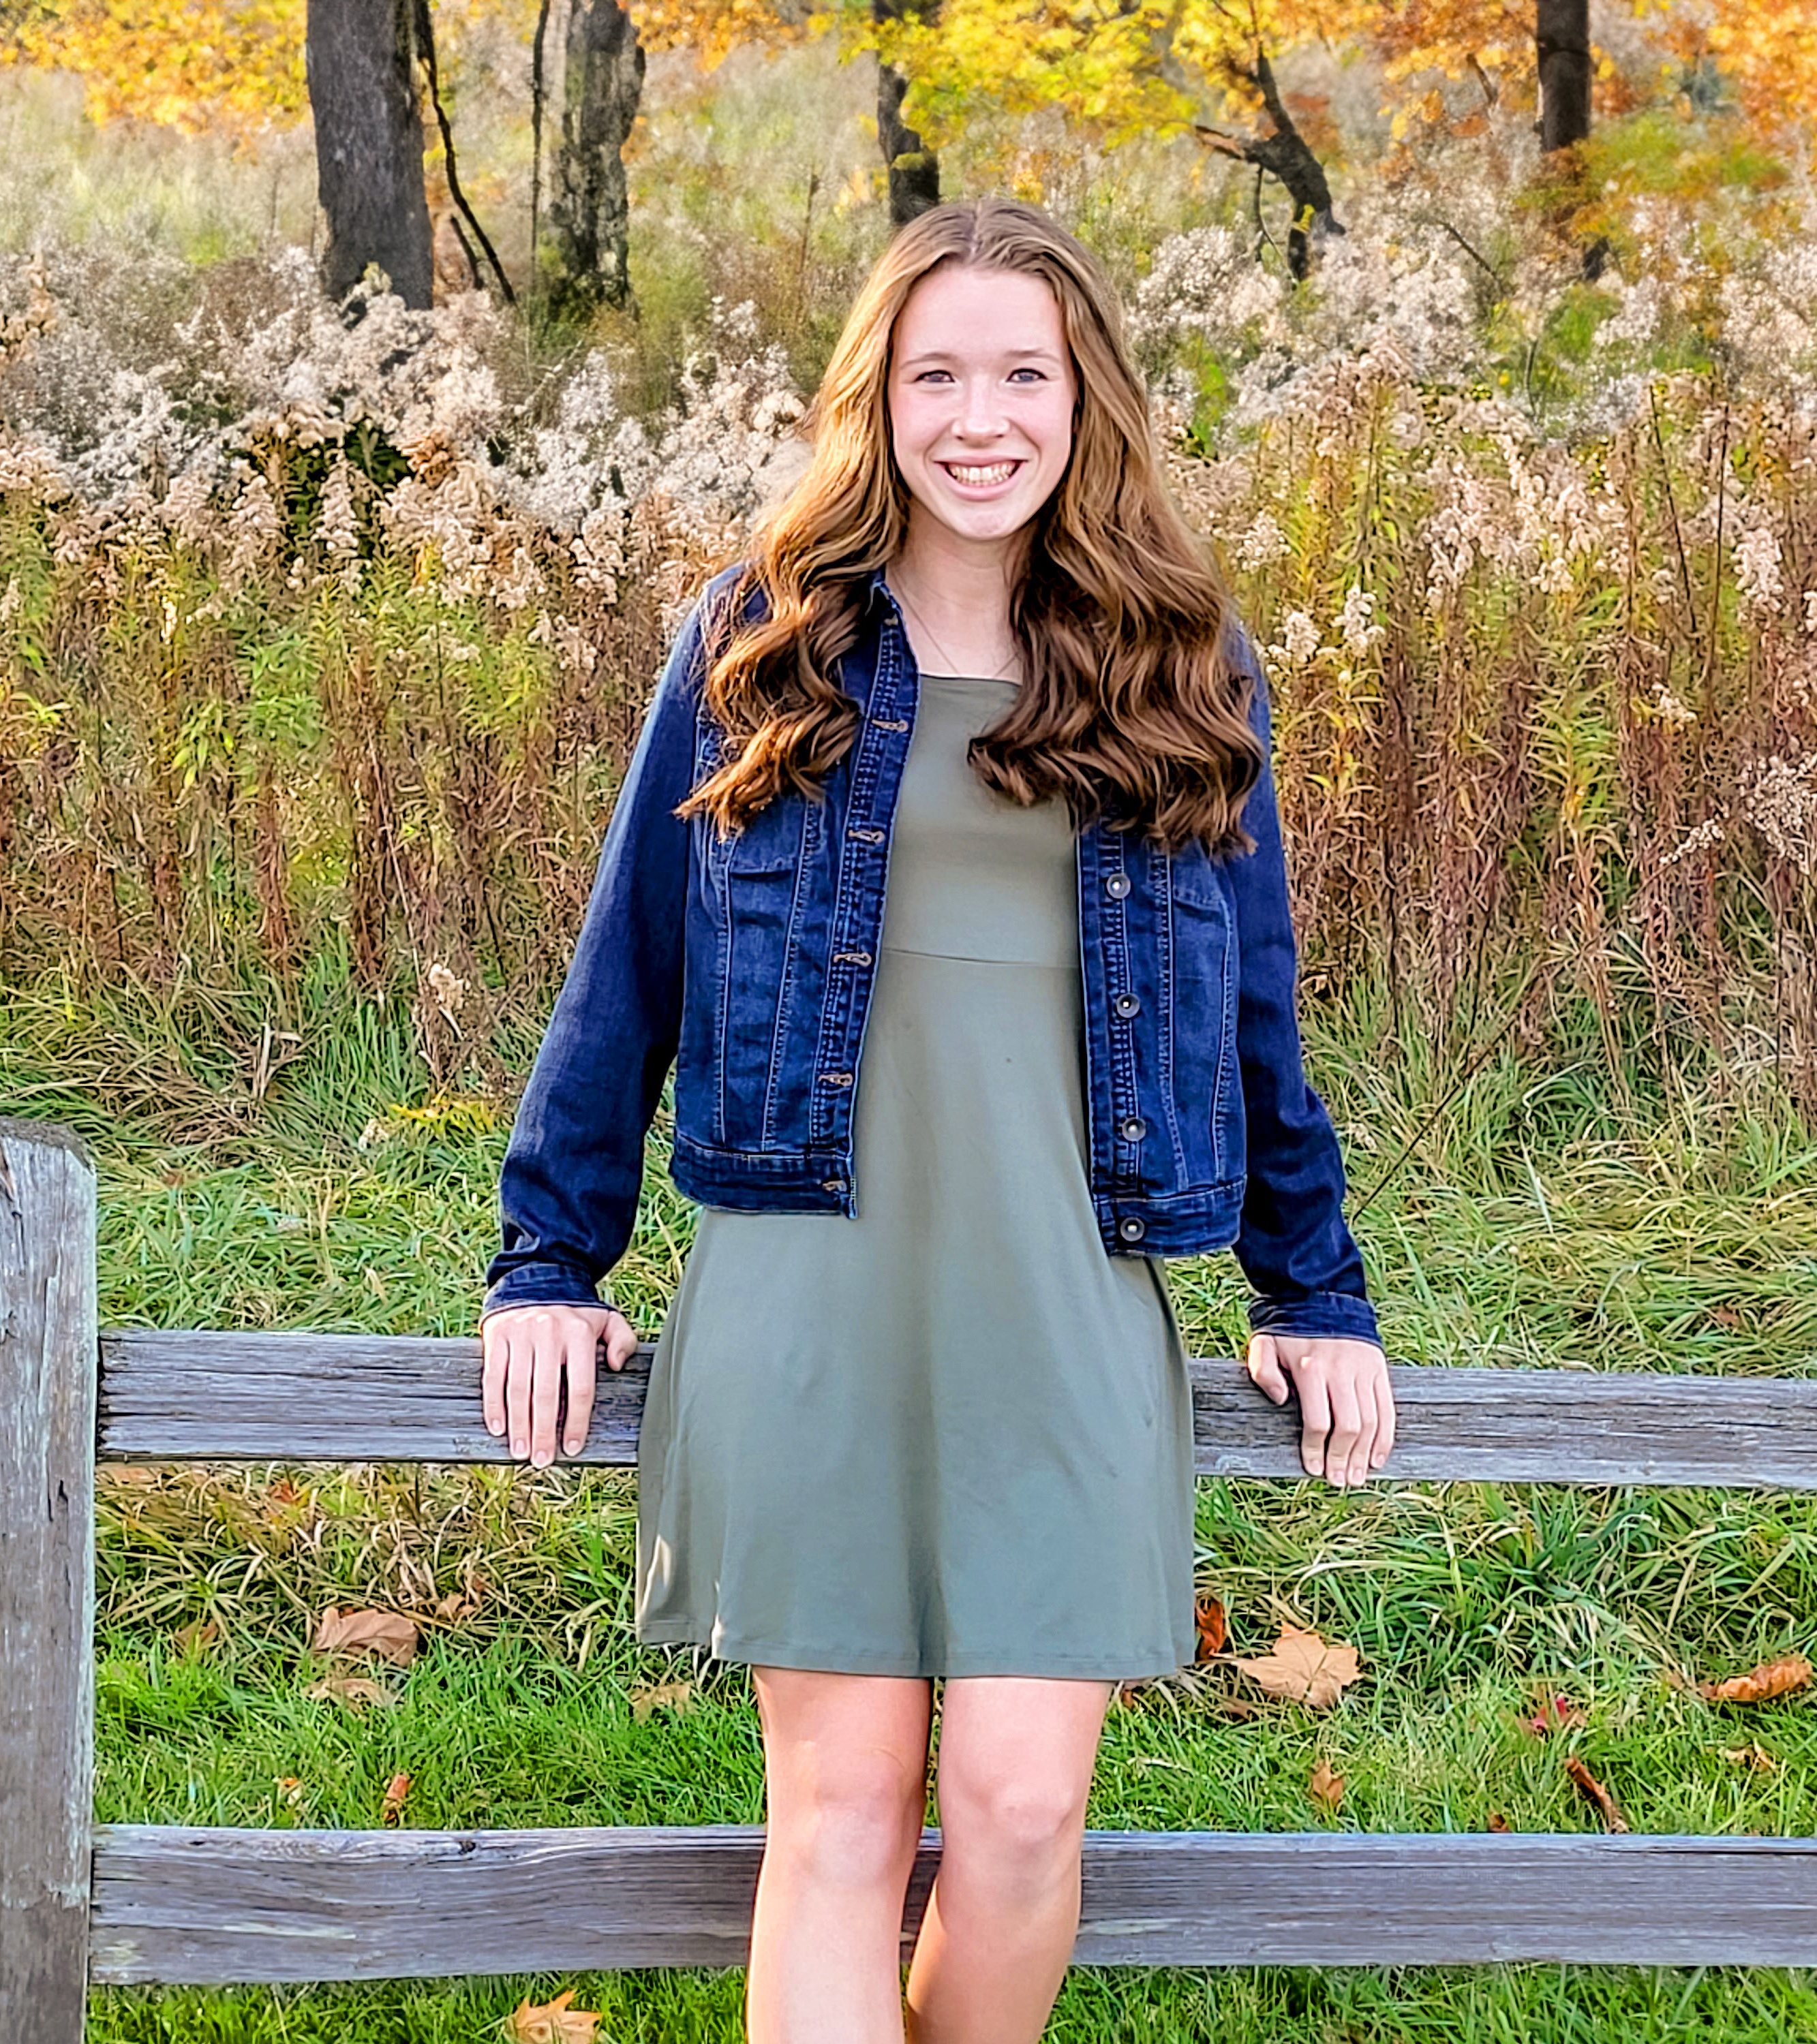
Rebekah Maxwell
Parkland College

Slide 38
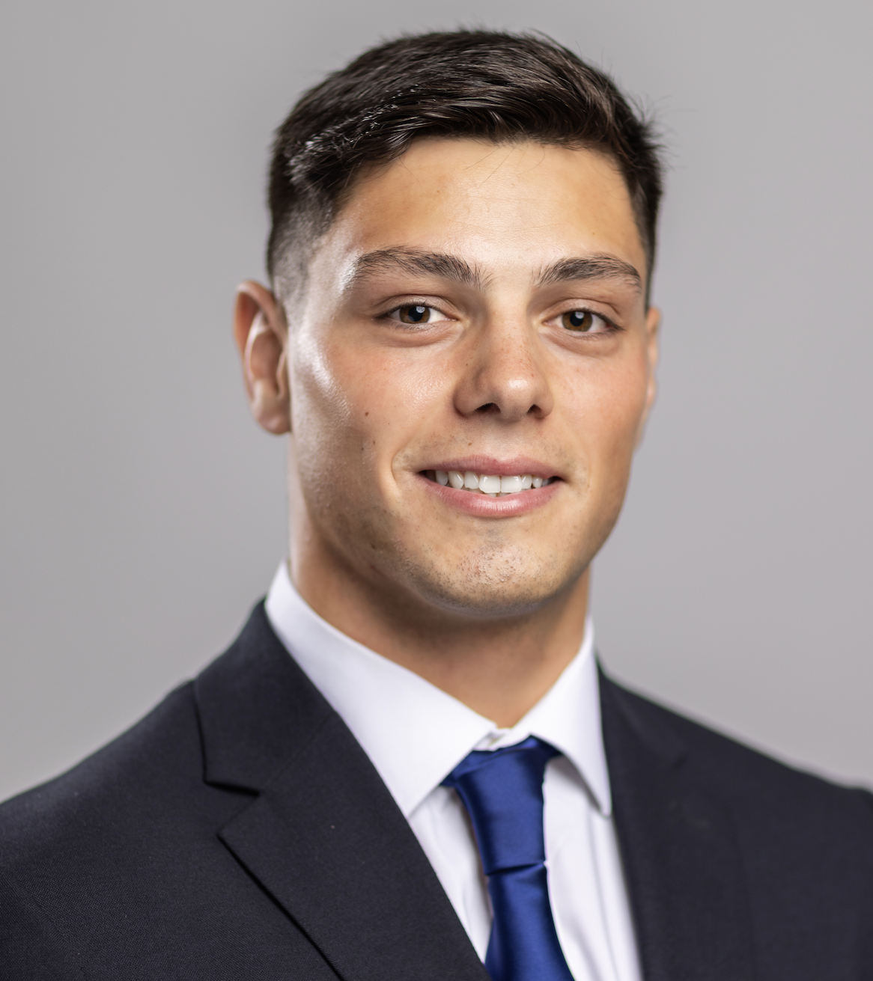
Juan Francisco Alessio
Principia University

Slide 39
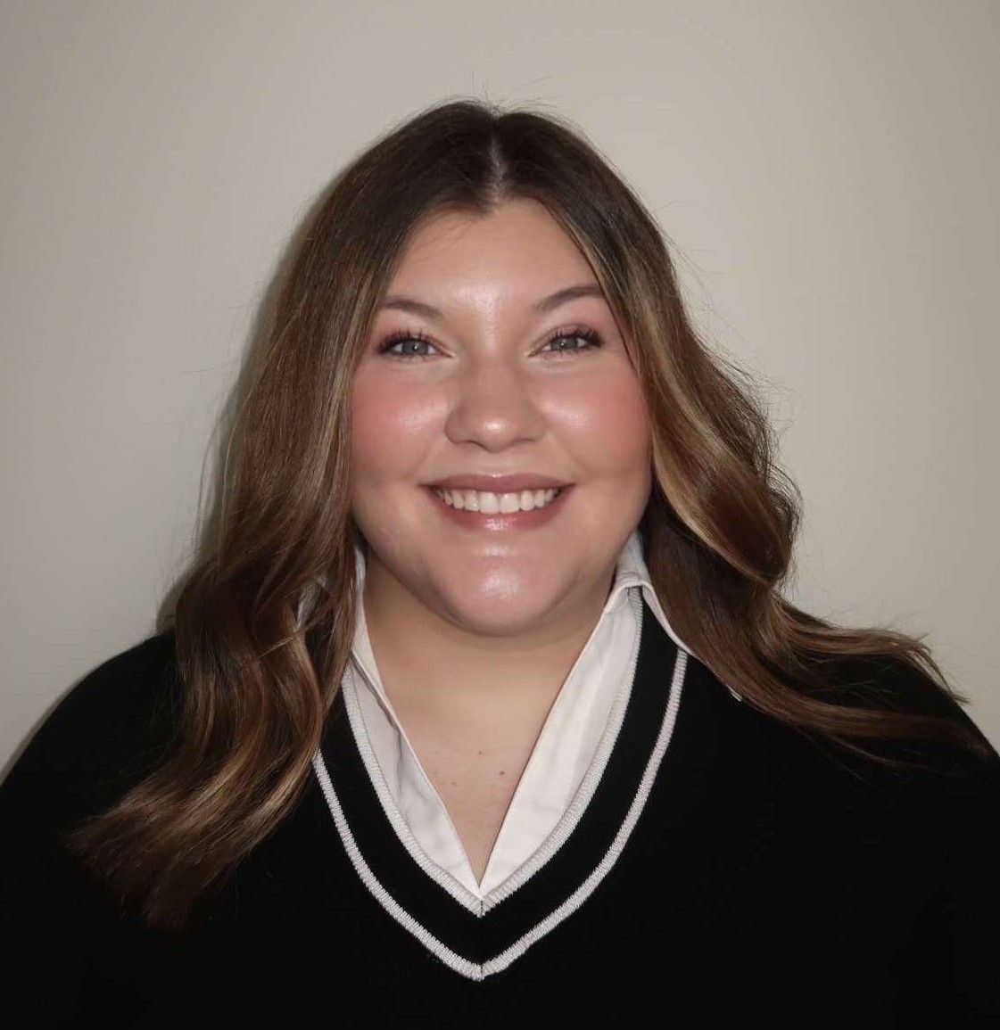
Alexis Nicole Stufflebeam
Quincy University

Slide 40
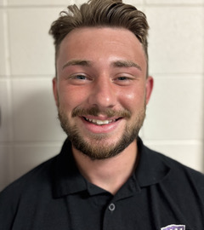
Kaden Thomas Finnestad
Rockford University

Slide 41
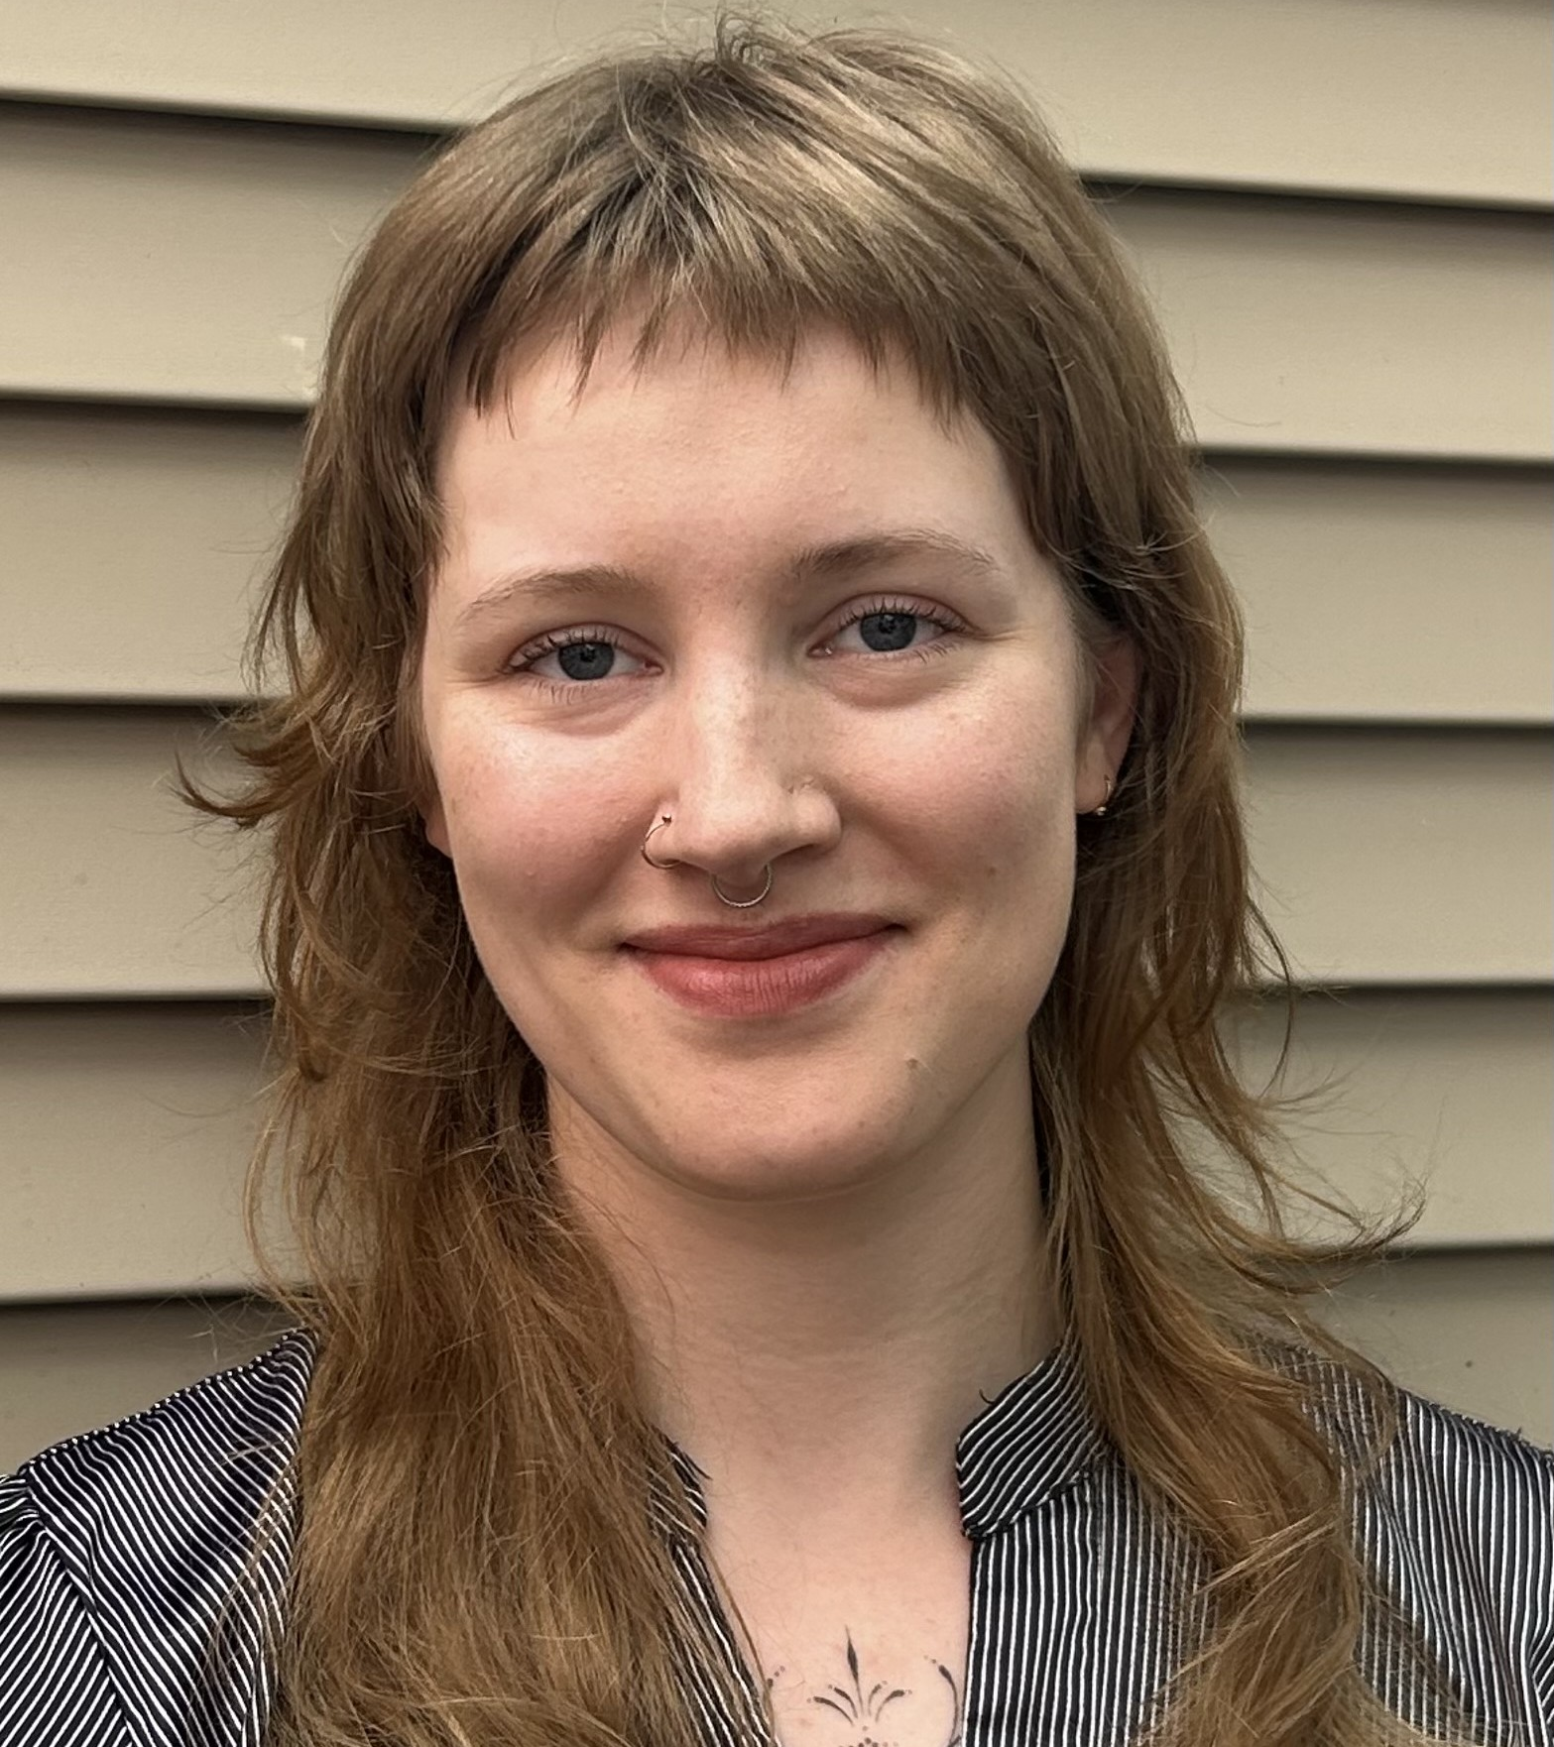
Aviana Joy Holst
Roosevelt University

Slide 42
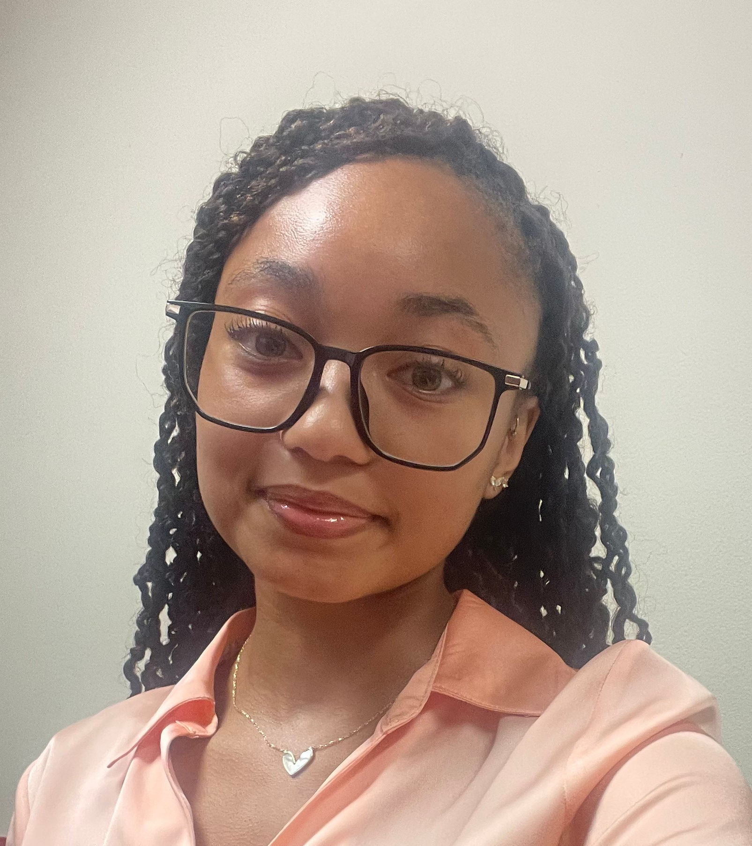
Chaylan Palmer
Saint Xavier University

Slide 43
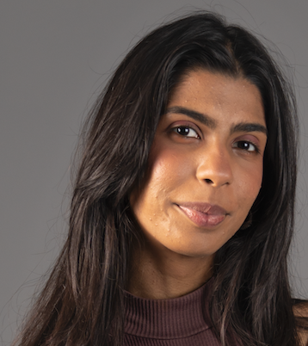
Aalika Bharti
School of the Art Institute of Chicago

Slide 44
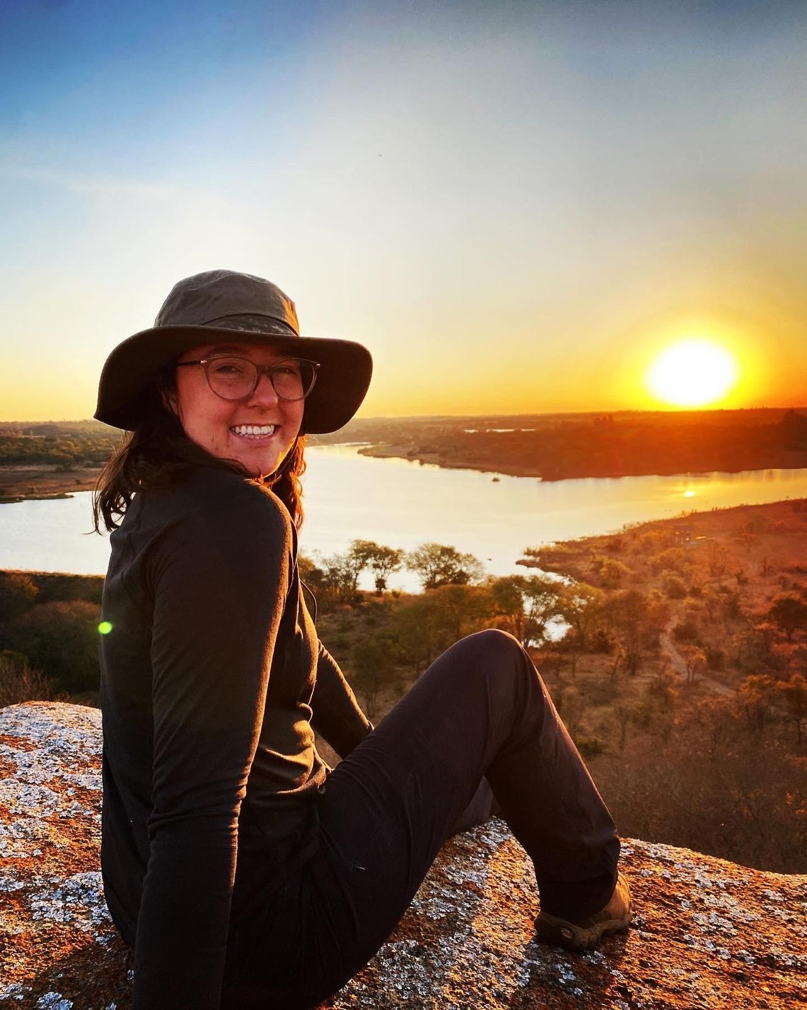
Marsden Lee Fisher
Southern Illinois University Carbondale

Slide 45
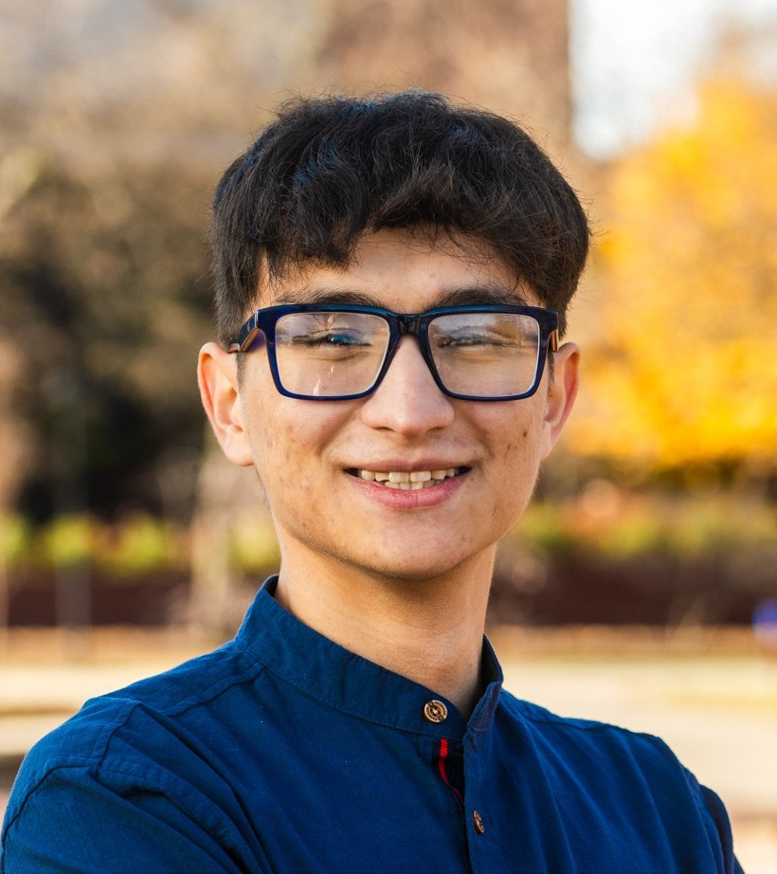
Baymuhammet Baltayev
Southern Illinois University Edwardsville

Slide 46
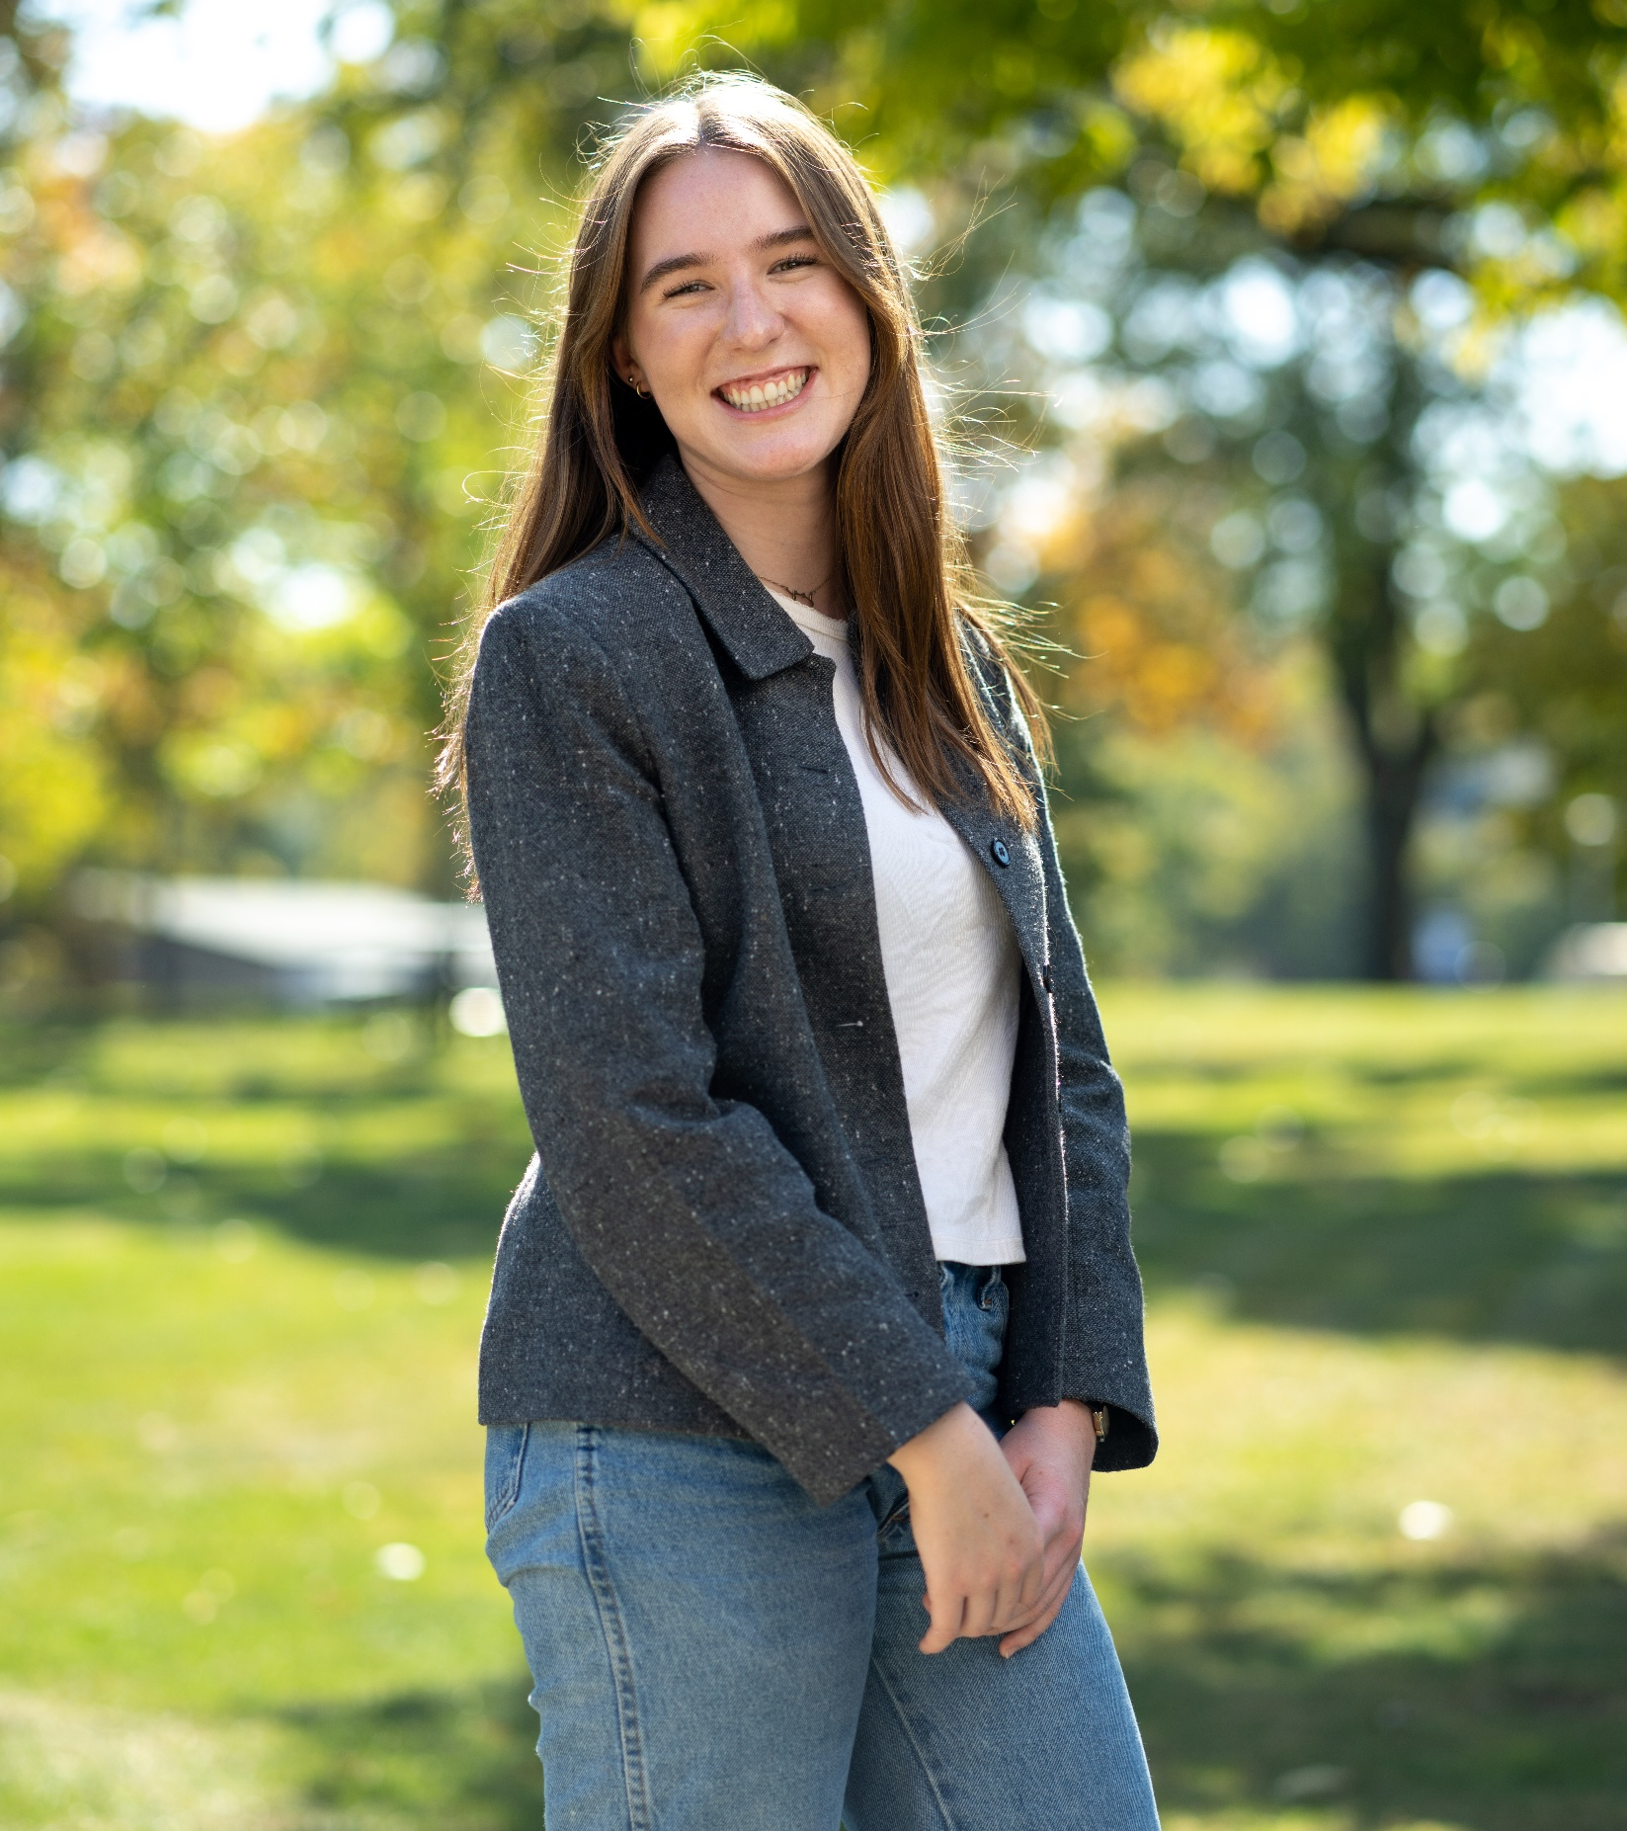
Mia Joy Musick
Trinity Christian College

Slide 47
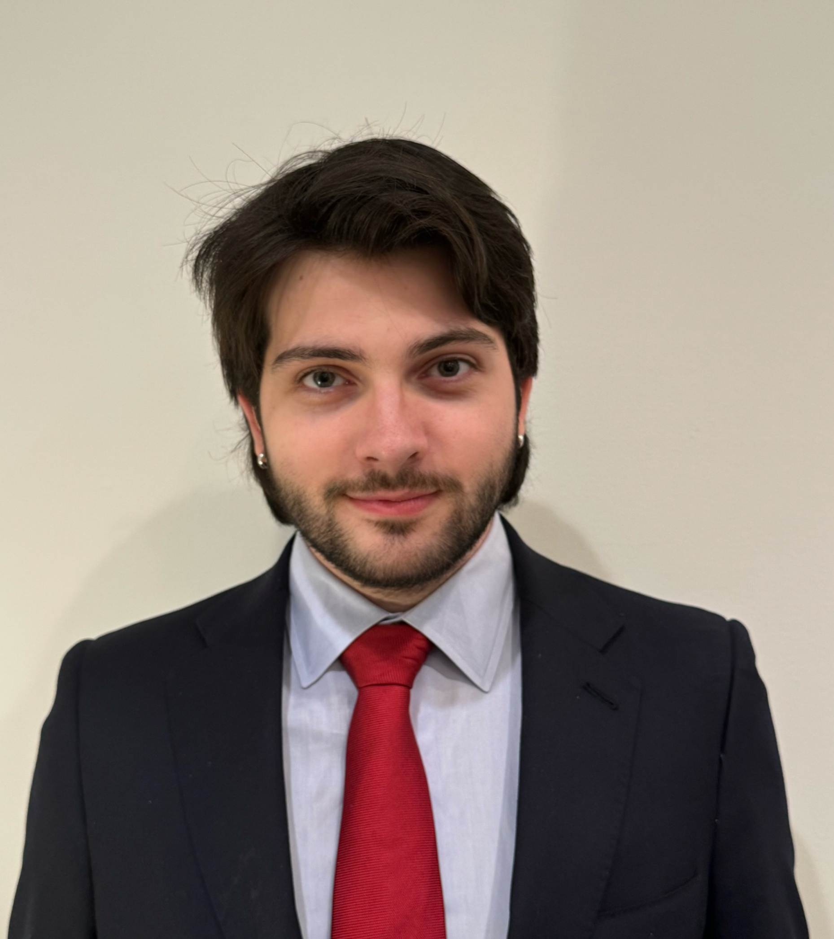
Daniel Brett Kind
University of Chicago

Slide 48
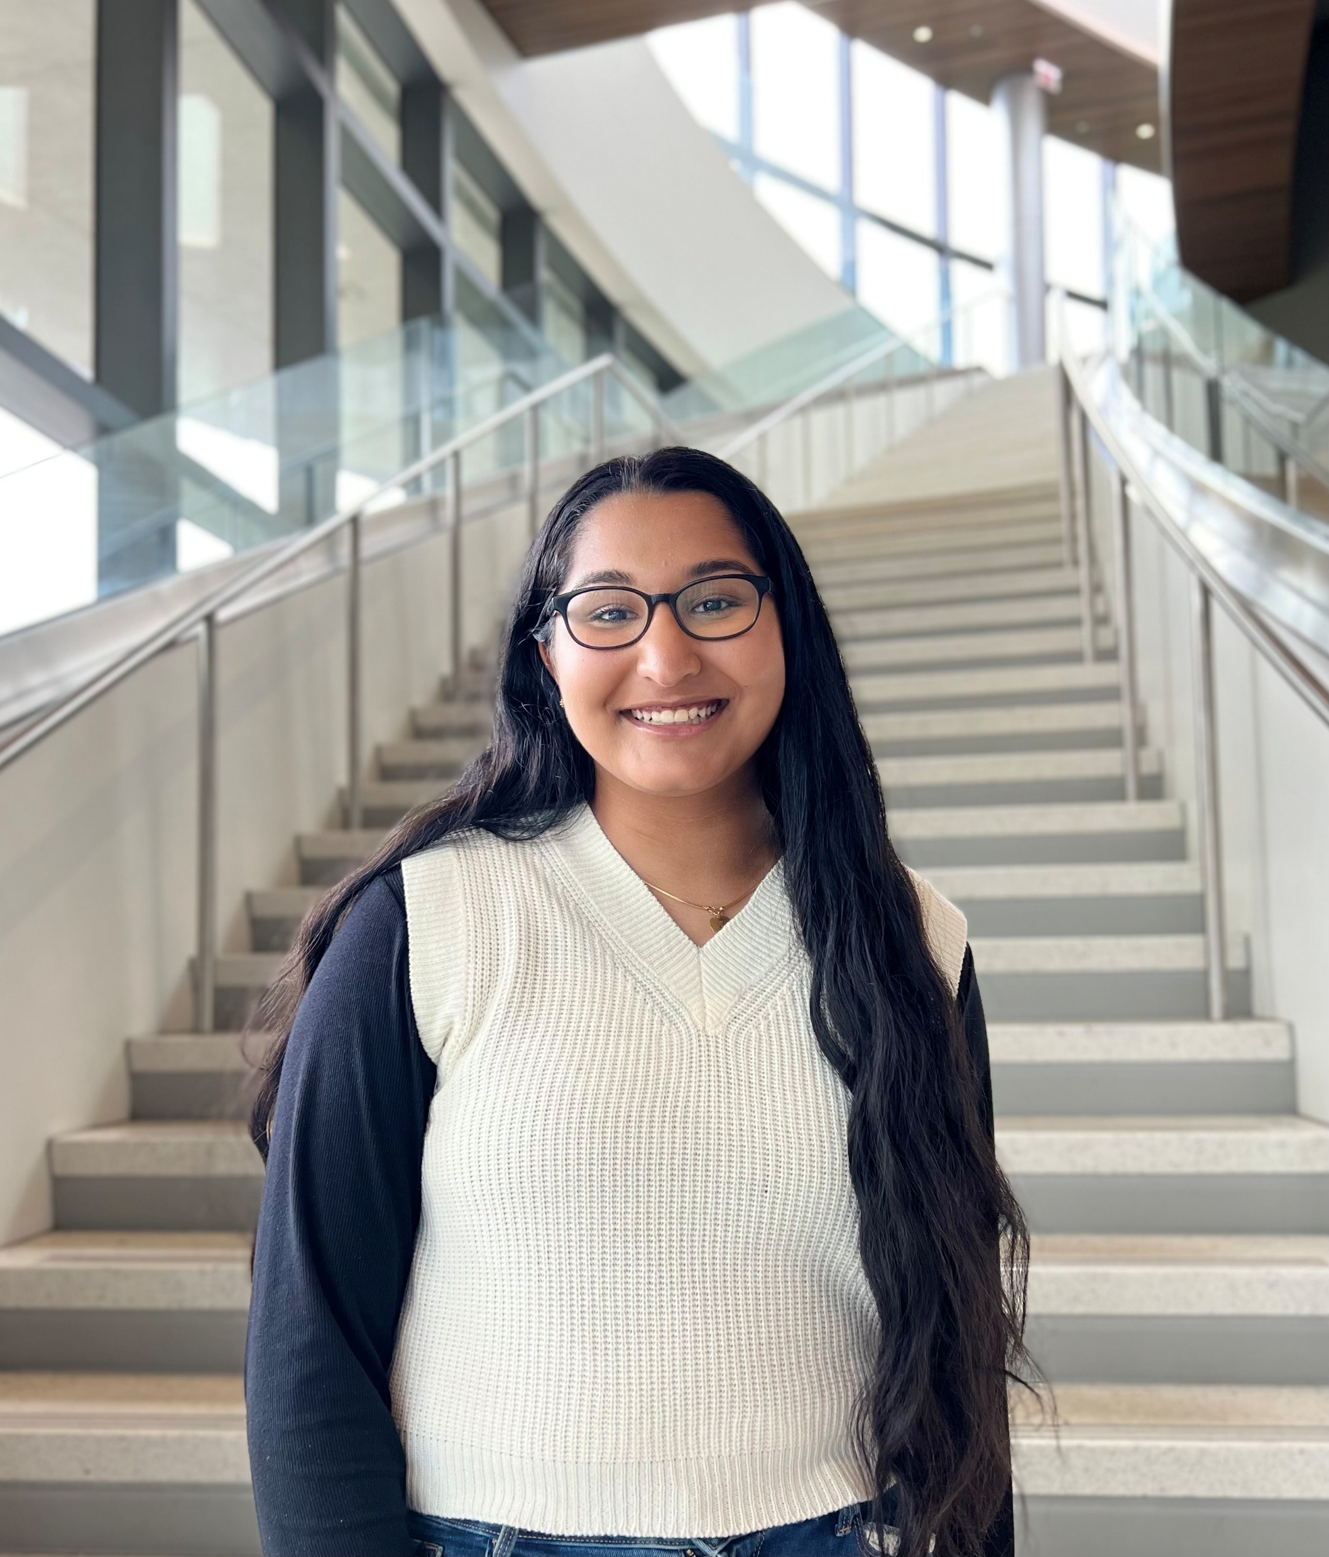
Aparna Ramakrishnan
University of Illinois Chicago

Slide 49
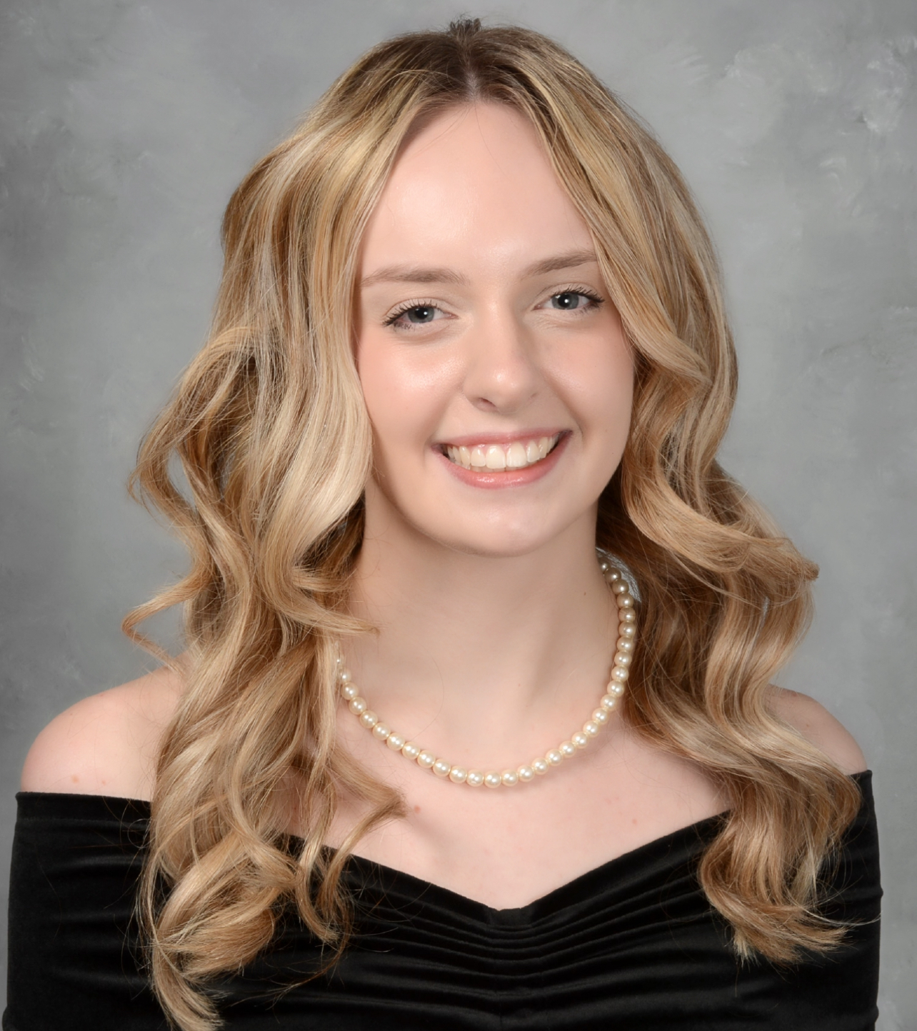
Abigail Leigh Hemmer
University of Illinois Springfield

Slide 50
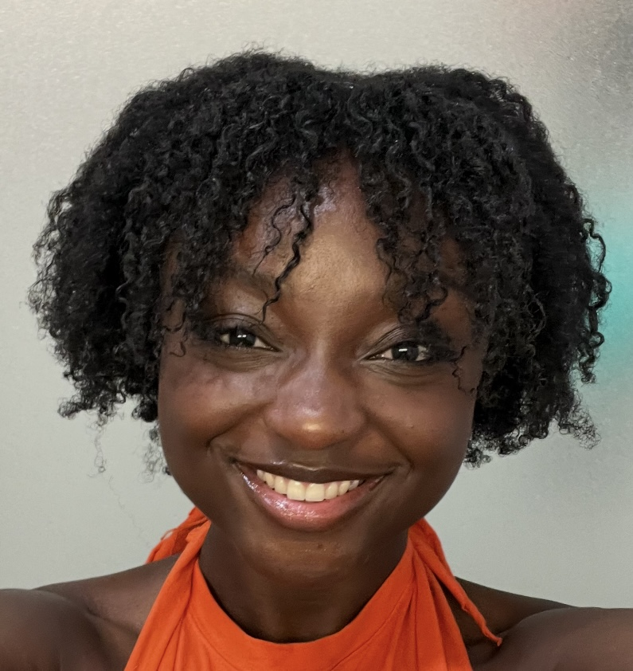
Ashley Denise Oliver
University of Illinois Urbana-Champaign

Slide 51
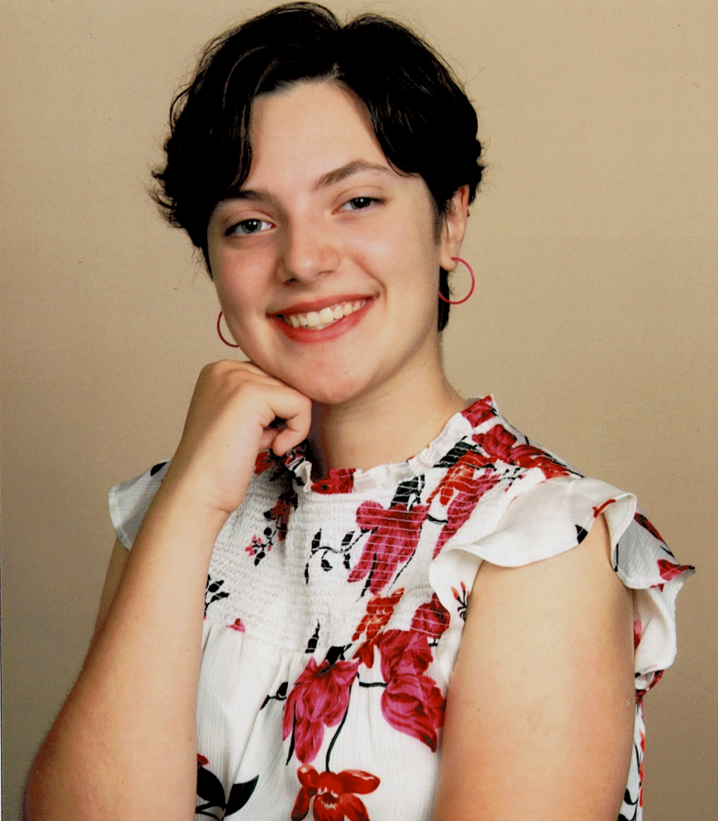
Gianna Marie Barbaro
University of St. Francis

Slide 52

Brandon Rogelio Zavaleta
VanderCook College of Music

Slide 53

Julietta Nora Marini
Western Illinois University

Slide 54

Olivia Madlin Wiebe
Wheaton College

